Slide 1

Adverse effects across different OAT medications a systematic review and meta-analysis
Maximilian Meyer
UPK Basel
Swiss Addiction Research Day, 13.03.2026

Slide 2
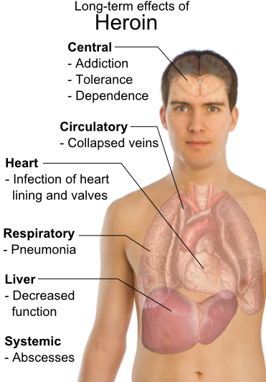


Why is this interesting?
We already know what opioids do to the body!
Source:businessnews.sg/the-long-term-effects-of-heroin
Source:businessnews.sg/the-long-term-effects-of-heroin

Slide 3
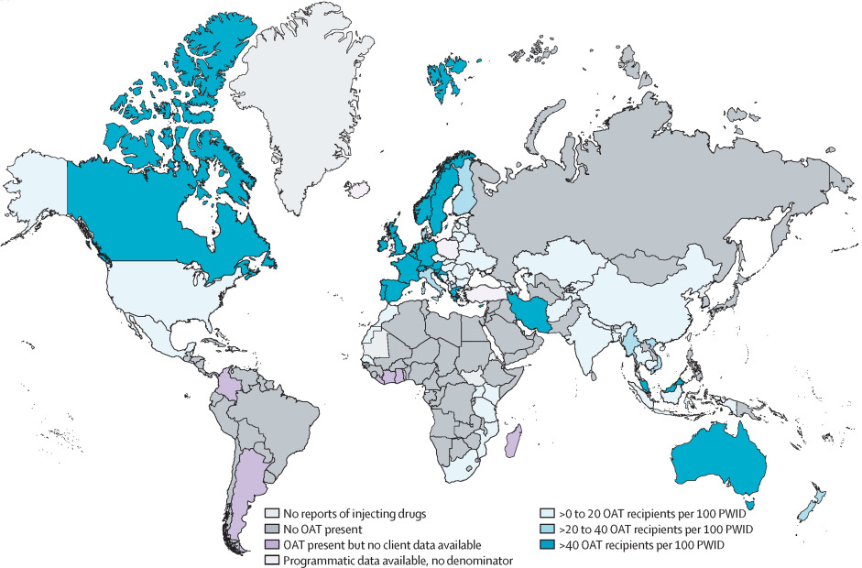

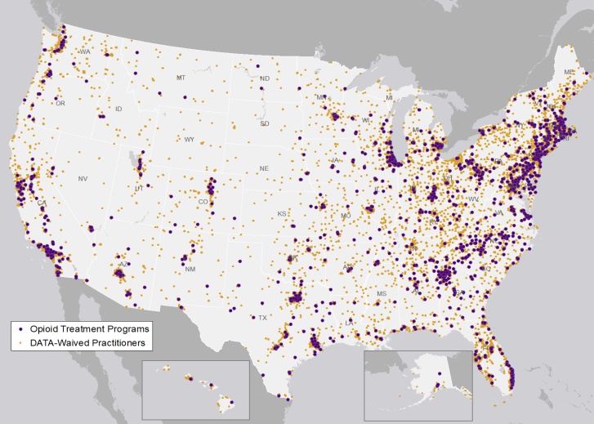


Why is this interesting?
Colledge-Frisby et al. (2023)
Source: CRS analysis using data from the Substance Abuse and Mental Health Services Administration as of May 9, 2019
Notes:
In the USA, OAT coverage is about 21% and only BUP/MTD are used. Below the areal coverage of addiction treatment centres is shown.

Slide 4
Why is this interesting?
Gmel & Labhart (2025), tao-oat.ch (2025)

Slide 5
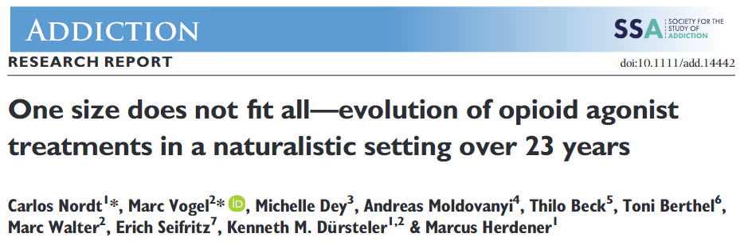
“There is no evidence for an excessive demand for a single medication in a naturalistic and liberal opioid agonist treatment setting”

Slide 6

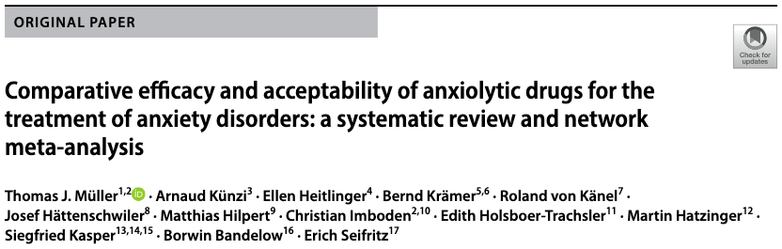

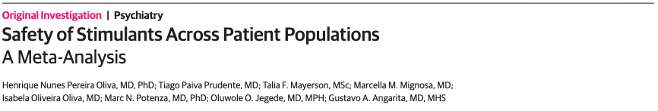






All the other guys have it…

Slide 7
Research Question
P | Population | OAT recipients
I | Intervention | Opioid agonist for maintenance treatment
C | Comparison | Two different agonists or two different routes of administration
O | Outcome | Number of adverse effects per group
S | Study type | Randomised Controlled Trials
Search strategy development and search
Screening and extraction
Statistical analysis

Slide 8
Outcomes
Constipation
Sedation
Pruritus
Sweating
Nausea
Headache
Non-headache pain

Slide 9
Identification of studies via databases and registers
Identification of studies via other methods
Records identified from:
Databases (n = 7092)
[Embase (n = 1917), Medline (n = 1441), PsycInfo (n = 982), CENTRAL (n = 1448), WoS cc (n = 1304)]
Records removed before screening:
Duplicate records removed (n = 3513)
Records marked as ineligible by automation tools (n = 0)
Records removed for other reasons (n = 0)
Records identified from:
Reference list checking (n = 4)
Identification
Records screened
(n = 3579)
Records excluded
(n = 3400)
Reports sought for retrieval
(n = 179)
Reports not retrieved
(n = 2)
Reports sought for retrieval
(n = 4)
Reports not retrieved (n = 0)
Screening
Reports excluded:
Adverse effects not assessed (n = 37)
Secondary report from RCT (n = 35)
Wrong comparator (n = 30)
Not an RCT (n = 22)
Adverse effects not obtainable (n = 20)
Wrong intervention (n = 9)
Reports assessed for eligibility
(n = 177)
Reports assessed for eligibility
(n = 4)
Reports excluded:
Not an RCT (n = 2)
Adverse effects not assessed (n = 1)
Studies included in review
(n = 25)
Included

Slide 10
Results
49 comparisons overall
  Several trials or one large trial in 30 comparisons
1-9 trials per comparison
16 to 1558 participants per comparison

Slide 11
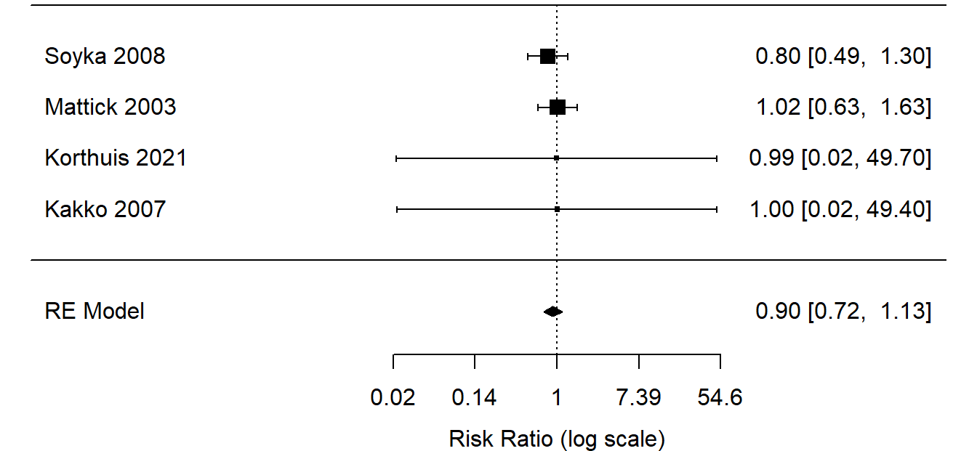
Results
Constipation
Nausea
Diacetylmorphine vs. Hydromorphone
(RR, 0.30 [0.09 – 0.96])
Methadone vs. LAAM
(RR, 0.56 [0.37 – 0.85])
Sedation
Sweating
Diacetylmorphine vs. Hydromorphone
(RR, 3.24 [2.01 – 5.22])
Buprenorphine vs. Methadone
Buprenorphine vs. Methadone
(RR, 0.68 [0.56 – 0.82])
Methadone vs. SROM
(RR = 0.63 [0.58–0.69])

Slide 12
Results

Slide 13

Wow, very impressive

Slide 14
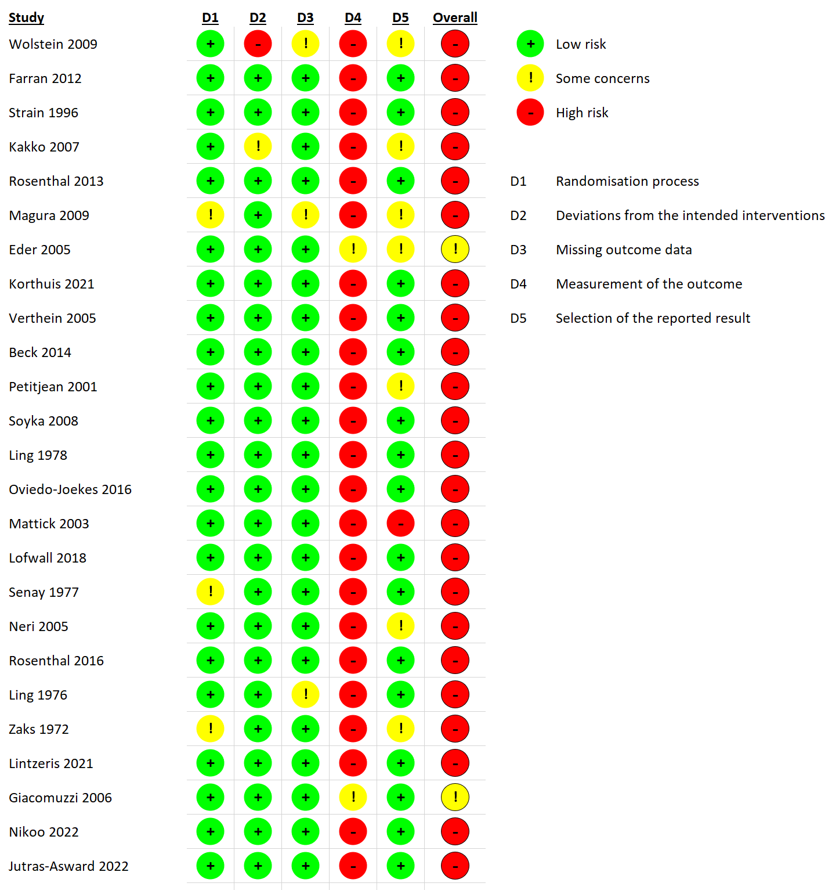
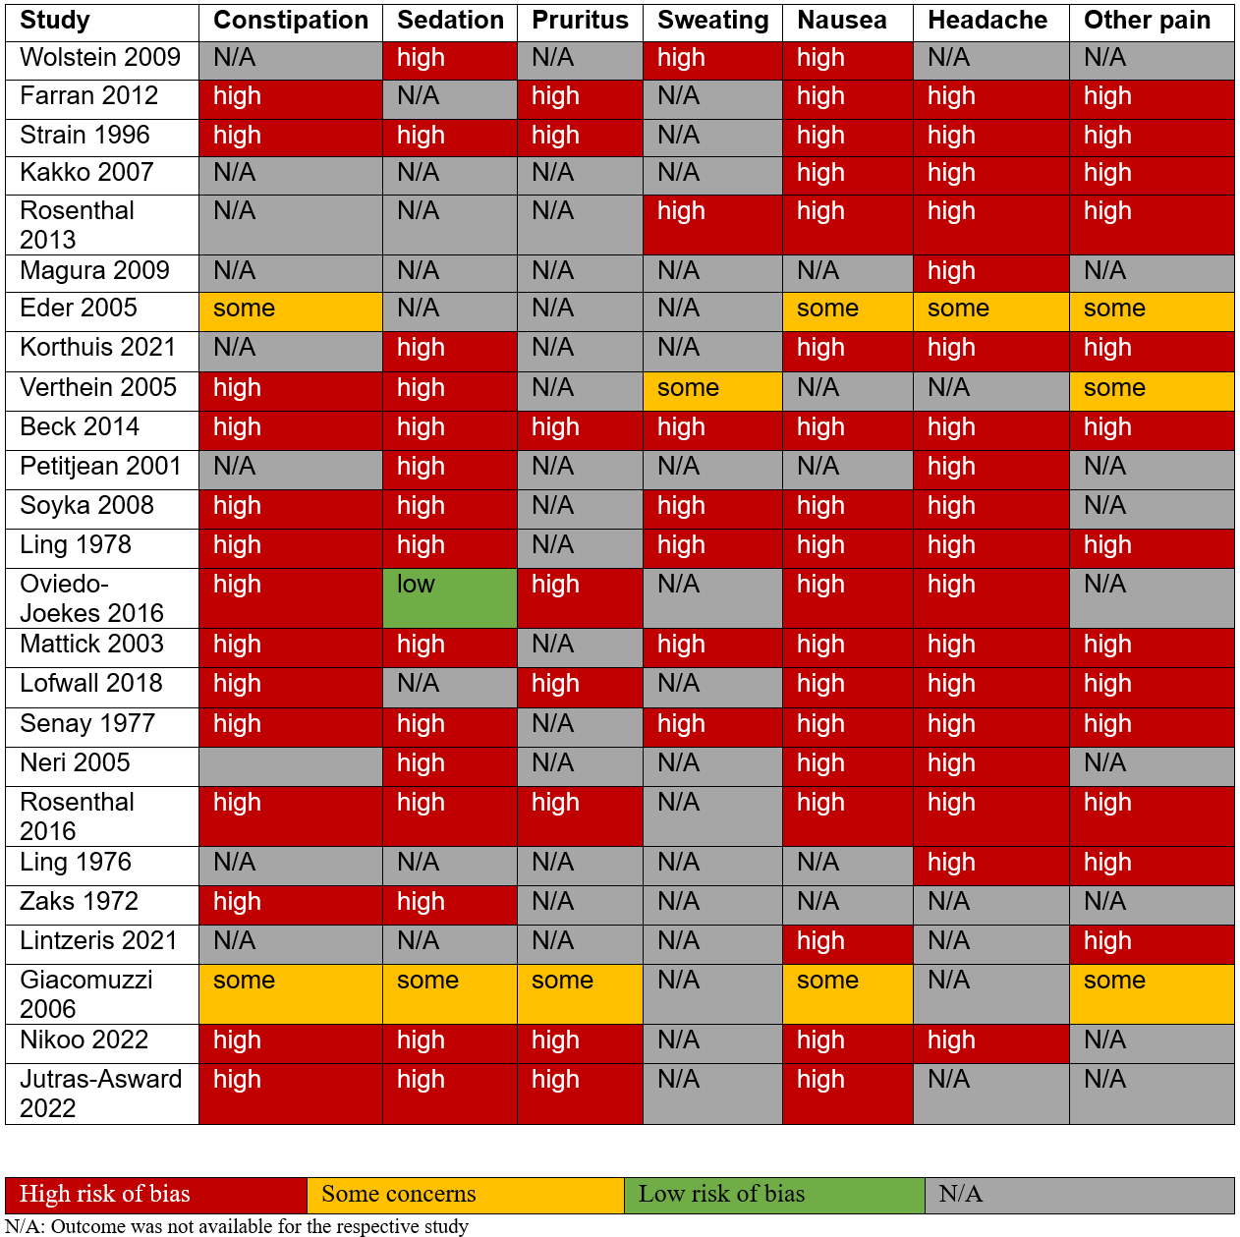
Risk of Bias

Slide 15

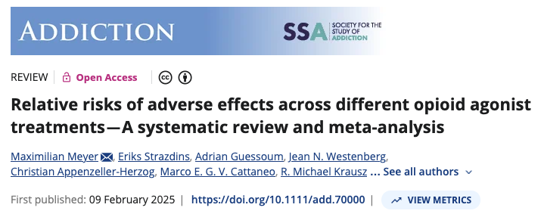
Thank you for listening!
addictionresearch.ch

