Slide 1


Designing the Geneva Model of Cannabis Regulation
For Profit vs. Consumer Literacy
Daniele Zullino

Slide 2






Goals of regulation
Public
Health
Products quality control
↓ Prosecuted
persons
↓ Black market
↑ Taxes

Slide 3



Harm
Reduction
Risky
Behavior
Hazardous
Product
Risky
Environment

Slide 4
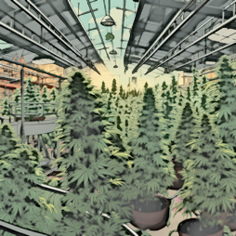
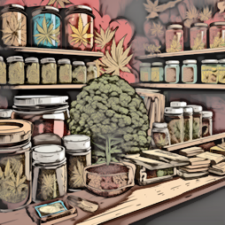

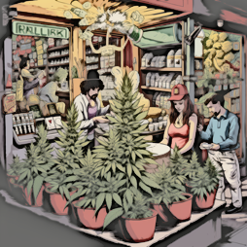

Cultivation
Processing
Distribution
Retail
Consumption

Slide 5



The models
(pseudo)
Medical
Free market
(for profit)
Home cultivation
(non profit)
Mixing two application areas (different regulations)
Risks:
- Medical bureaucratization
of civil rights
- Charlatanism
Able to replace rapidly significant portions of black market
↑ taxes
Public health secondary
Cave: Big cannabis
Lobbying

Slide 6
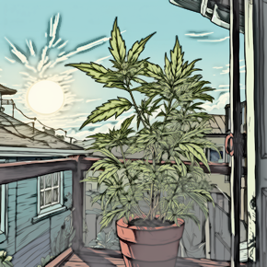

Home cultivation
Individual cultivation at home
Usually covers only part of the demand
Collective cultivation Social clubs
produce for members in a collaborative manner

Slide 7

The models
(pseudo)
Medical
Free market
(for profit)
Home cultivation
(non profit)
State
Monopoly
Mixing two application areas (different regulations)
Risks:
- Medical bureaucratization
of civil rights
- Charlatanism
Able to replace rapidly significant portions of black market
↑ taxes
Public health secondary
Cave: Big cannabis
Lobbying
Potential ↓ black market
Targets its best customers
Demand-oriented production
Includes harm reduction
Cave: Individuals who share a culture of cannabis use
Best way to take into account public interests
Considered illiberal
Sale itself in hands of profit or non-profit organizations

Slide 8
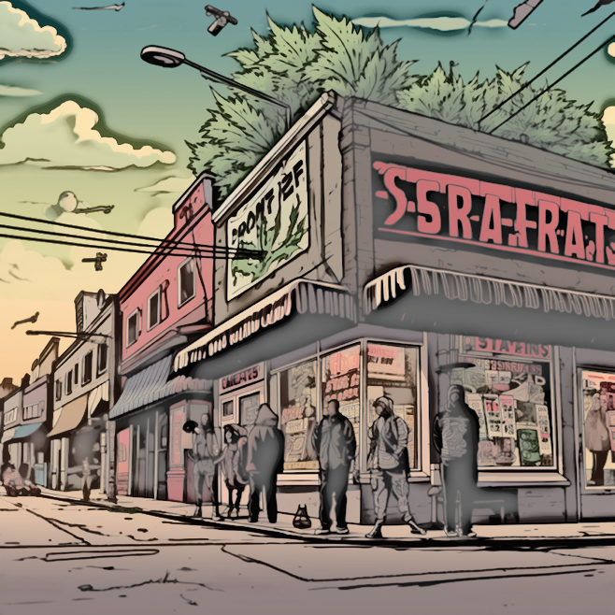
Behavioral economic substitutability analysis
    Explores how demand for a commodity changes in the presence of an alternative product
    Canadian data → asymmetric substitution
    Availability of legal cannabis → ↓ Demand for illegal cannabis
    Availability of illegal cannabis → no effect on demand for legal cannabis
Hursh 2014; Amlung & MacKillop, 2019

Slide 9

Pilot projects - History
Since early 2010s, launch of municipal and cantonal initiatives
Article 8 Narcotics Act : Exceptional authorizations by the FOPH for scientific research
2018 University of Berne project refused
2019 University of Geneva project refused

Slide 10
Narcotic Act, Art. 8a Pilot trials
After consulting the cantons and communes concerned, the Federal Office of Public Health may authorise scientific pilot trials involving narcotics containing an effective concentration of cannabinoids:
a. that are limited in terms of location, time and subject matter;
b. that allow findings to made on the impact of new regulations on the use of these narcotics for non-medical purposes and on the health of participants;
c. that are conducted so as to ensure the protection of health and of minors, and the protection of public order and public safety; and
d. in which, if possible, cannabis products are used that are of Swiss origin and that comply with the rules of Swiss organic farming.
…

Slide 11

Pilot trials
Can be conducted by private or public organisations
  E.g. universities, local authorities, research institutes, associations or foundations
  A recognised research institute must be involved
  Points of sale to be approved by relevant municipal authorities
  Ethics committee mandatory

Slide 12

Pilot trials: Limitations
Limited geographically to one or several communes
Limited to five years
Legislation governing pilot trials applies from 15 May 2021 to 14 May 2031
Participants limited to the number necessary required for the trial to be scientifically significant (max 5,000)

Slide 13

Pilot trials: Products
Both unprocessed products (e.g. cannabis flowers) and processed products (e.g. hashish, extracts)
Products may be designed to be smoked, inhaled, vaporised, or eaten or drunk (e.g. edibles)
Must originate from organic farming and not contain any contaminants that pose a health risk

Slide 14

Pilot trials
Flowers: max 20% THC
Edibels: max 10 mg per unit
Max 10 g THC / person / month
  ≈ 50 g flowers with 20%THC
  Max 10g Flowers per purchase

Slide 15
Geneva Project
Cannabinothèque
Social club
production and delivery mandate
association under the swiss civil code
1. institunional members
2. Individual members (professionals)
3. Users
mandate to operate the Cannabinotheque
State monopoly
Harm reduction
Consumption competence
Early intervention

Slide 16

Geneva Project
Specificities
Association composed of representatives of Geneva's health authorities and specialists in the fields of addiction, health, prevention, social work, communication, education and politics
Association's main partner: Service of social cohésion, Municipality of Vernier
range of municipal partners (municipal police, social workers, social and health services, etc.)
Non-profit nature of sales
Creation of the "Cannabis Community“

Slide 17

Geneva Project
The Cannabis Community
Autonomous organizational form within the association
Relaying consumption literacy actions (organization of workshops, information sessions and other events)
Taking part in project governance
→ Avoiding a passive “opportunistic consumer" posture
→ Empowering them as co-promoters of the approach

Slide 18


Medicalisation
Civilisation
Economisation

