Slide 1
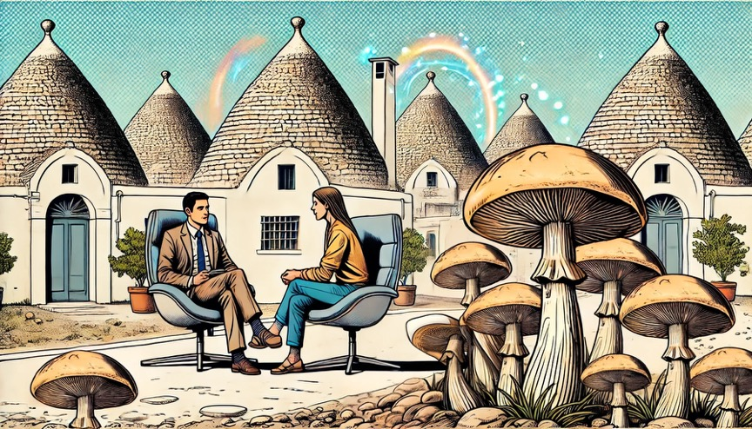


Psychedelic-assisted psychotherapy - How to catalyze the mechanisms of psychotherapeutic action
Daniele Zullino
WHO collaborating center

Slide 2


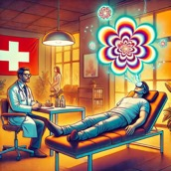



It happened in Switzerland
1943
1958
1988 – 1993
2006
Since 2014
Albert Hofmann
discovers LSD
Albert Hofmann
discovers psilocybin
Exceptional permit
for 5 physicians
100th anniversary
Albert Hofmann
Compassionate
use
1970
Richard Nixon
does not like psychedelics
It happened elsewhere…

Slide 3

In Geneva since 2020
> 250 patients
> 350 sessions

Slide 4


Therapy with psychedelics
?
Pharmacotherapy?
Psychotherapy?
Epidemiology: no persistant clinical effect of recreational use
Clinical studies: Always with at least minimal psychotherapeutic support

Slide 5
Persistent mental changes
Latency
mental changes
Receptor
occupancy
Receptor
occupancy
Hours
Days
Hours
Days
Weeks
Tretter, 2021

Slide 6


Psycholytic therapy
Psychedelic therapy
Developed in Europe
Psychoanalytically inspired
Repeated low-to-medium doses
Therapist intervenes during session
Mainly studied in North America
1-3 higher doses
Peak experience
Therapist does not intervene during session

Slide 7
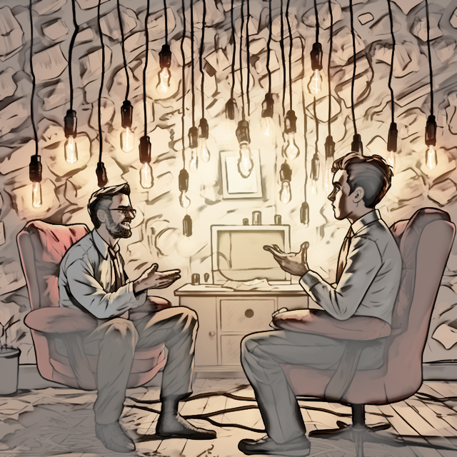
What is psychotherapy?
Generation of choices
Sharpening the perception of possibilities
"What is" → "What could be“
Catalysis of self-organization processes

Slide 8


Psychiatric disorder
Recovery
Neural reorganization
Neuroplasticity
Psychotherapy
Monopolizing
cognitivo-behavioral
attractors
Re-developing
possible selves

Slide 9

Psychotherapy
A clearer view of certain aspects of the world
Drawing attention to what's essential

Slide 10


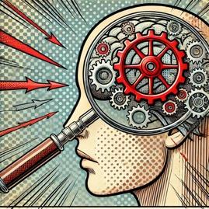

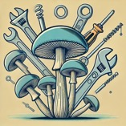
Instrumental
objectives
Essential
objectives
Psychotherapy
Mechanisms of action
Universal / Specific
“Tactical” objectives
Life plan
Values
“Strategic” objectives

Slide 11



Essential
objectives
Possible
selves
Core
values

Slide 12



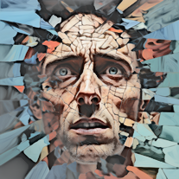

Fundamental dimensions of psychedelic experiences
altered state of consciousness ASC
visionary restructuralization (VIR)
anxious ego-dissolution (AED)
oceanic boundlessness (OBN)
Pseudo-hallucinations / illusions
Synesthesia
Changes in the meaning of perceptions
Vivid memories
Self-disintegration
Sense of loss of control
Sense of alienation from environment
≈ «bad trip»
Very pleasant state of ego expansion
Shifts in the boundaries of the self
Experience of unity and transcendence of space and time
Sense of intuitive understanding
Elevated mood, bliss, ecstasy
Preller & Vollenweider, 2018

Slide 13


Algorithmed task
Heuristic task
  Following a set of established instructions
      along one single path
          to one predifined result
  Routine tasks
  No algorithm exists
      Experimenting with possibilities
      Development of new solutions
  Creating something the world didn't know it was missing
Pink, 2009

Slide 14
Divergent
thinking
Convergent
thinking
Quantity over quality
New, original ideas
Creation of choices
Analysis and filtering
Useful ideas
Decision making

Slide 15

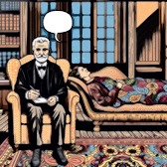



Universal mechanisms of action
Specific mechanisms of action

Slide 16





Therapeutic alliance
reflects the quality of the relationship between therapist and patient
Clarification of meaning
implies the conscious reflection of (un)conscious motives of one’s own behavior
Problem actuation
implies actual emotional experiences of one’s problem in therapy sessions
General change
mechanisms
Resource activation
refers to the purposeful use of the patients’ individual abilities for therapeutic change
Mastery
refers to the learning of concrete strategies to cope with problem situations

Slide 17
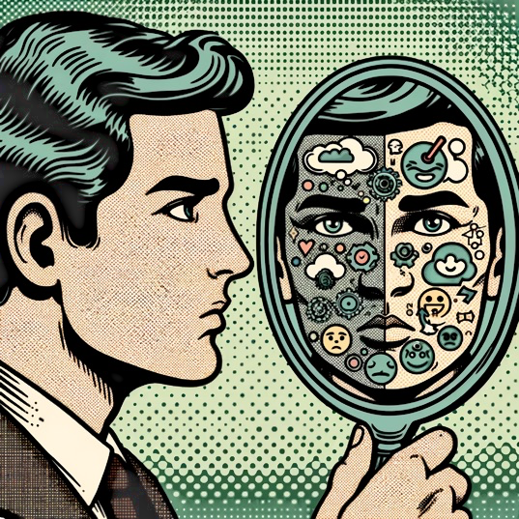
Decentering
The ability to observe one's thoughts, emotions and bodily sensations with impartial detachment.
Without judging or identifying with them
Observe the thought process rather than its content
Safran & Segal, 1990

Slide 18


Decentering
CBT
Psychedelic
decentering
Induced by cognitive restructuring techniques
Involves identifying and challenging maladaptive thoughts
Short-term and dependent on therapeutic interventions
Occurs spontaneously
↓ egocentricity
Deeper, more immersive decentration
Long-lasting, even beyond the peak effect

Slide 19










Objectives of psychotherapy
Life plan
Psychotherapy
Values
Universal
mechanisms
of action
Specific
mechanisms
of action
Possible
Selves
Objectives of
psychedelic intervention
Peak
Experience
Procedures
PAP

Slide 20

Take home
Psychedelic treatments = psychotherapy boosted by pharmacological intervention
Importance of working on the set to maximize effect
Importance of integrating the psychedelic experience into a psychotherapeutic concept

