Slide 1
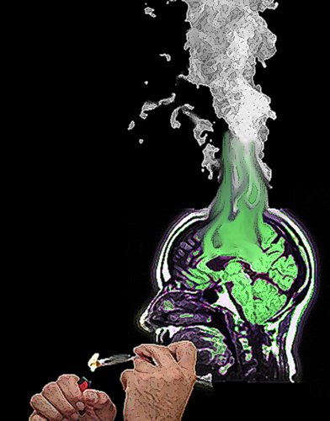


Daniele Zullino
Fallacious reasoning and
cannabis as a risk factor
WHO collaborating center

Slide 2
Risk of developing a chronic psychosis
6.81
THC any
THC addiction
THC low level
4.9
THC middle level
RR
THC high level
3.4
2.76
2.81
2.4
NIC any
2.14
2.28
1-9 cg
1.67
1.8
1.38
1.23
1.09
>10 cg
Weiser et al., 2004
Weiser et al., 2004
Weiser et al., 2004
Weiser et al., 2004
van Os et al., 2002
van Os et al., 2002
Weiser et al., 2004
van Os et al., 2002
Henquet et al., 2005
van Os et al., 2002
Ferdinand et al., 2005
Fergusson et al., 2003
Andreasson et al., 1987

Slide 3
Risk of developing psychotic symptoms
4
3.31
3.4
3.5
3
2.5
2.14
2
1.5
1.06
1.09
1
0.5
0
Tobacco
AUDIT 8-15
AUDIT >16
Using
Addiction
THC
THC
Wiles et al., 2006

Slide 4

Argument
Attempt to persuade someone of something
by giving reasons to accept a given conclusion
      A set statement or propositions (which can be true or false, but not both)
      one of the claims forms the conclusion
      the remaining are termed premises
      premises intended to offer reasons to believe/accept the conclusion

Slide 5
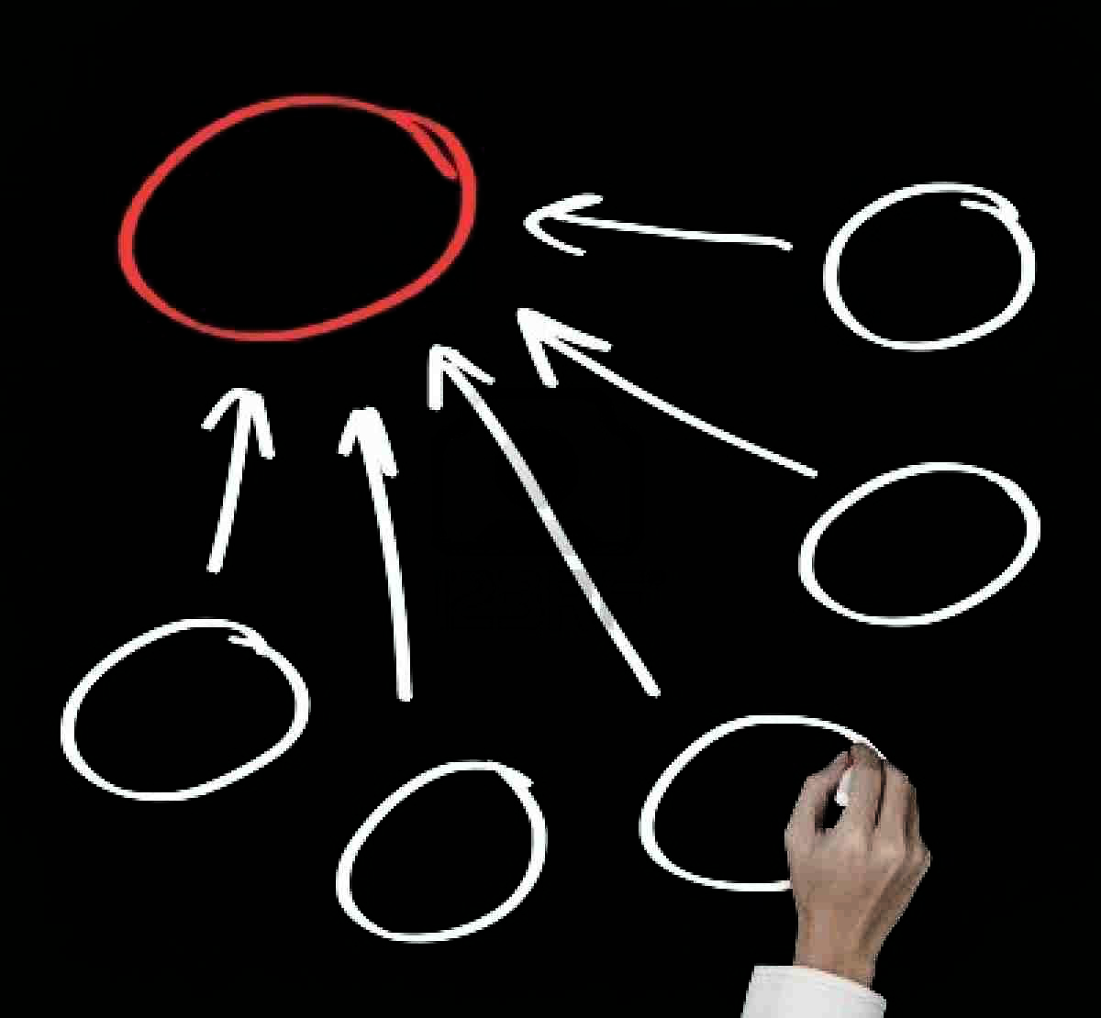
Argument
goal of an argument : to persuade
goal of logic and argumentation : to persuade for good reasons

Slide 6

Fallacies
Fallacies are bad arguments
because they have weak logic, or
because they rely on a false premise, or
they violate some other basic principle of argumentation
in fact may appear to be quite valid

Slide 7
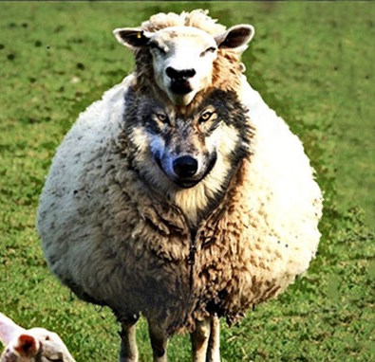
Sophism
A clever but false argument
Used deliberately to deceive
➛ intentionally used fallacies
➛ an attempt to persuade opponents that the specific conclusion is true, by means other than by proposing relevant evidence
Sophistry thus a matter of intention
http://oxforddictionaries.com/definition/english/sophism?q=sophism

Slide 8
Inductive fallacies
Hasty Generalization : inductive generalization about a population based on a sample which is to small to support it
Unrepresentative Sample fallacy: sample used is relevantly different from the population as a whole
Fallacy of Exclusion : excluding important evidence from consideration (violates the "principle of total evidence”)
➛ to be controlled by EBM and peer review

Slide 9
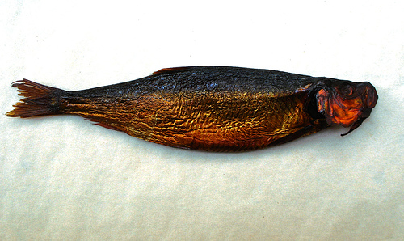
The red herring fallacies
Probably the most frequently observed fallacy in the context of scientific argumentations
Maneuver consists in distracting the opponent from following the track of the original argument
done by multiple means

Slide 10
The red herring fallacies
Introducing a new and different argument which raises a different issue, e.g. insisting on an indicator of the claimed conclusion instead of direct evidences
Making simply an irrelevant comment that distracts from the main issue, e.g. talking about something interesting related to the issue which is, however, not undoubtedly correlated to the claimed conclusion

Slide 11

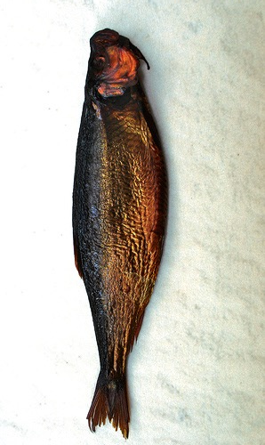
The red herring fallacies
Has its origin training dogs for fox hunting
Goal is to train dogs not to be distracted from the fox’s trail by smell of smelly red herrings

Slide 12
The red herring fallacies
Opponent is driven to “lose the original trail”
… to “follow the smell of the red herring”
Proponent using a red herring sophism avoids engaging the original argument
= fallacies of relevance: making use of premises, which are logically irrelevant to the final conclusion

Slide 13
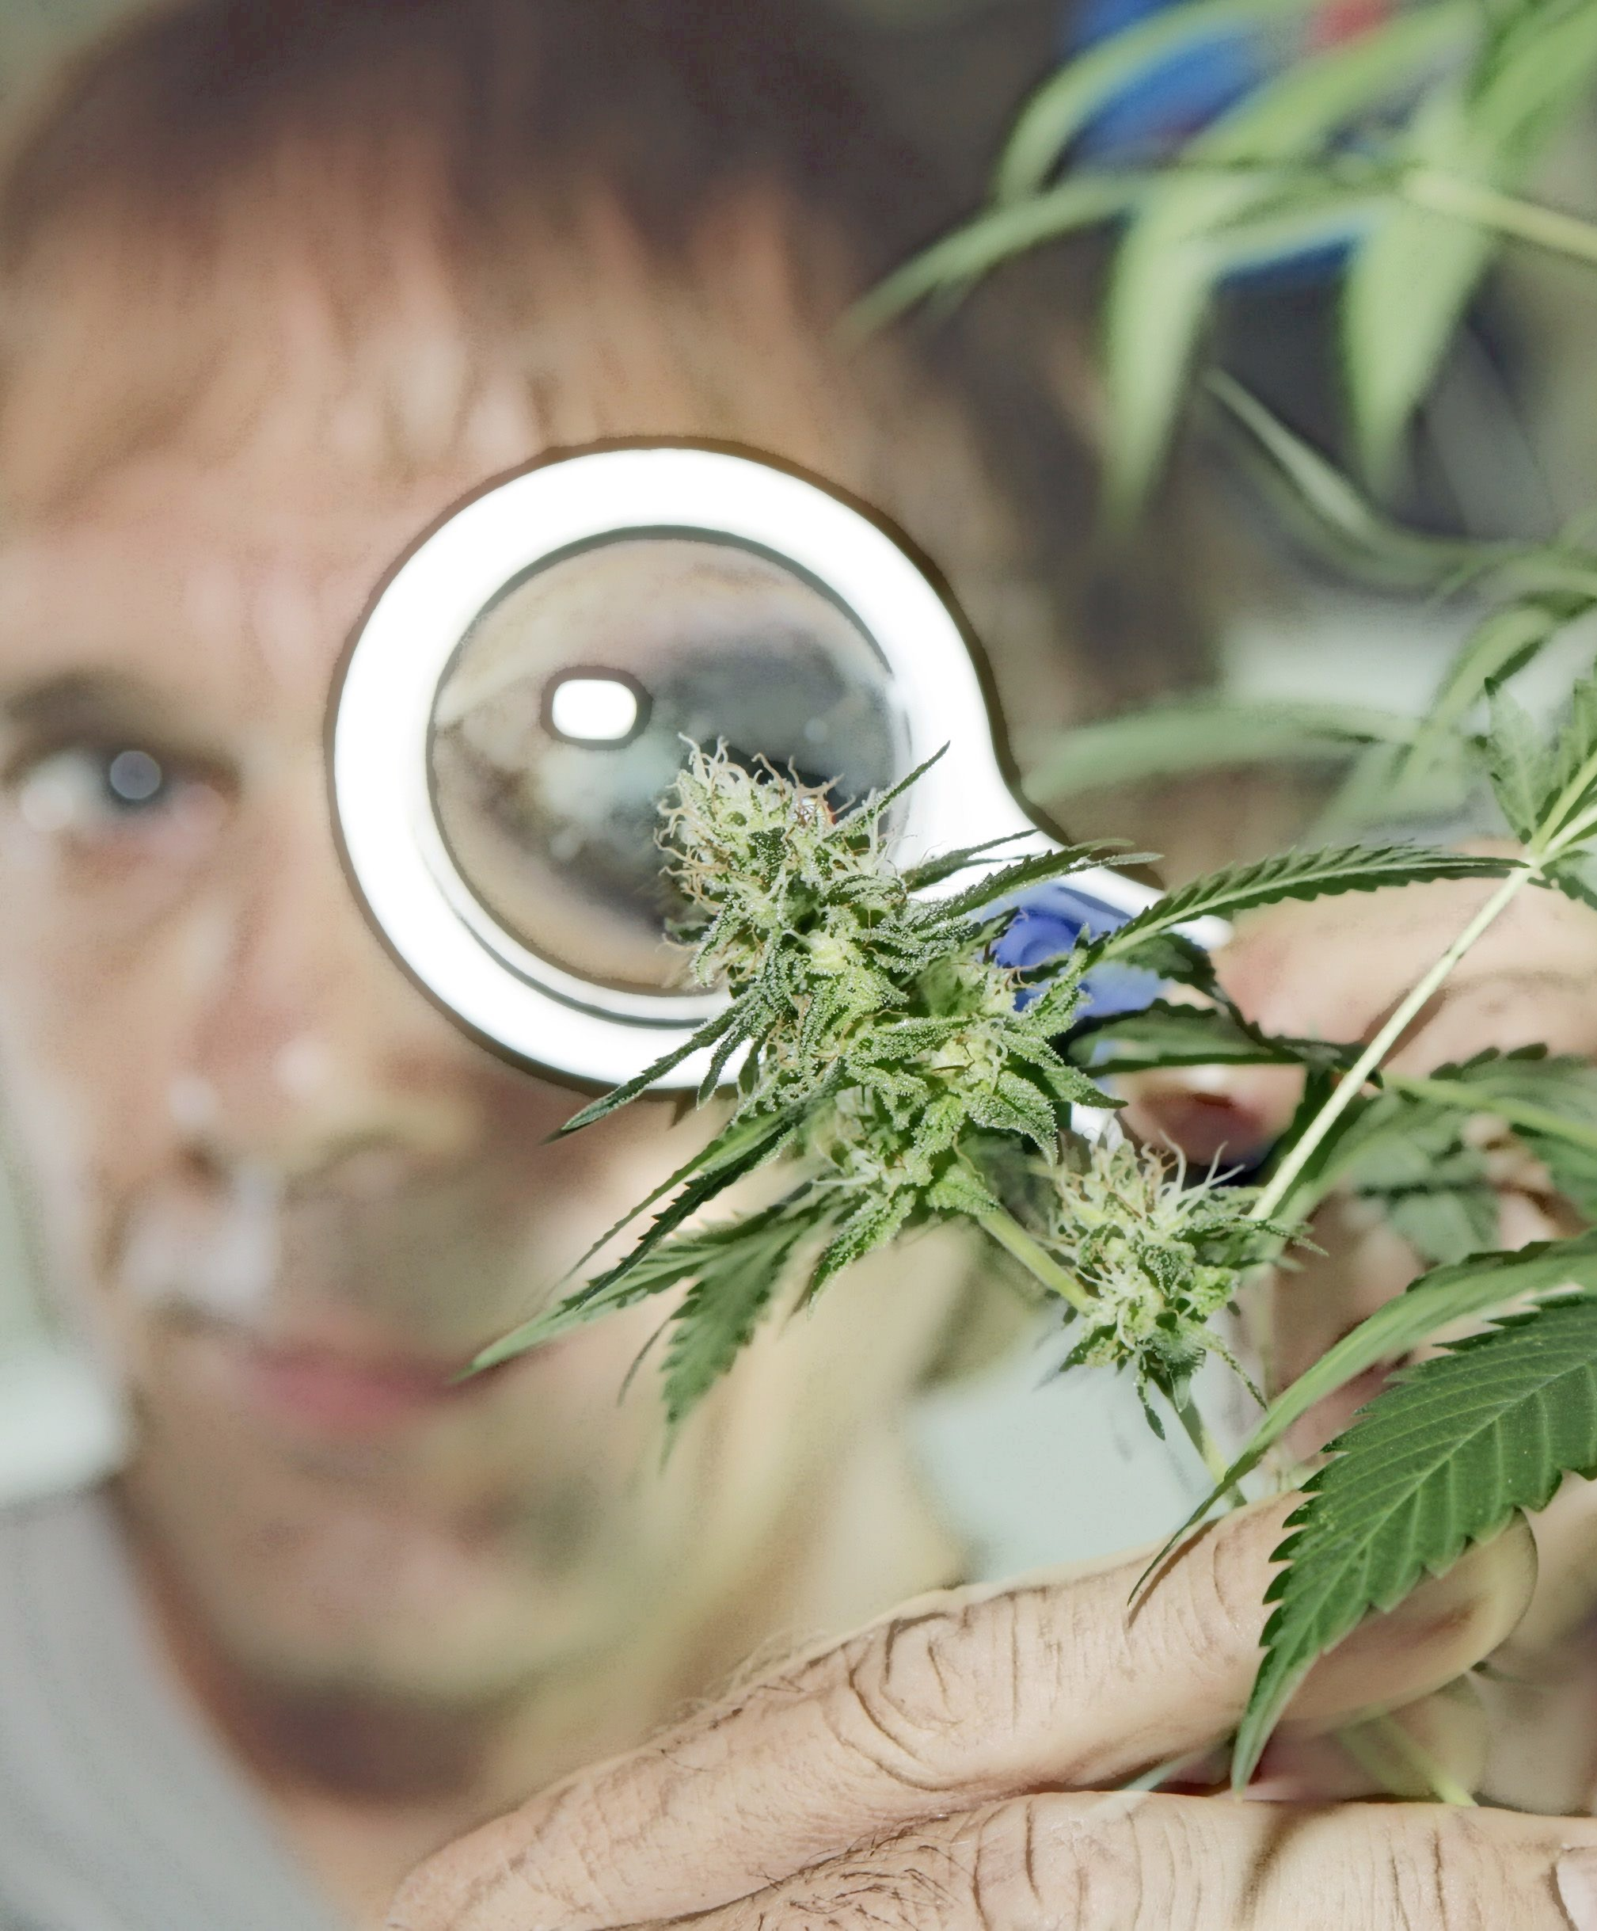
The red herring fallacies example
“My opponent has argued that evidence for cannabis’ causal effect regarding schizophrenia is lacking.
Newest evidence, however, shows an involvement of cannabis receptors in the pathophysiology of schizophrenia”
Original issue: evidence for cannabis causing schizophrenia
Response “side steps” the issue and introduces as new issue

Slide 14
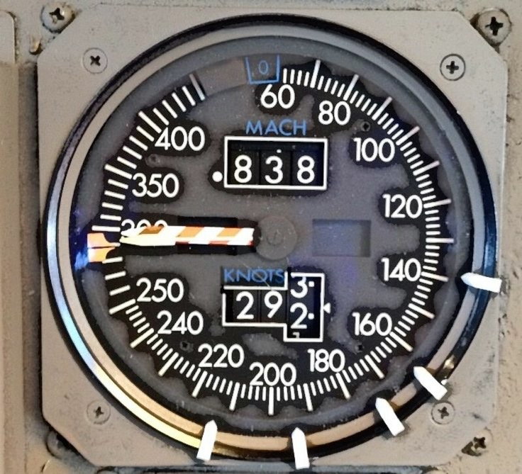
Indicators
“a thing that indicates the state or level of something”
a phenomenon (measure, observation etc.), which is in a certain correlation with another phenomenon that is itself the actual object of interest
useful if observation/measurement of actual object of interest not suitable (impossible, to expensive, to slow, to complicated, less comprehensible etc.)
➛ to argue on the basis of an indicator (e.g. psychotic symptoms) instead of the actual object of interest (e.g. chronic psychosis) could be judicious if the indicator was a valid and reliable measure for the latter
http://www.oxforddictionaries.com

Slide 15

Appeal to authority
Also : ad verecundiam
considering an argument as good or bad, or a claim as true or false, because an authority says so
Authority can be a person, a book, a website, an institution etc.
exploiting upon feelings of respect or familiarity with this authority (the red herring) in order to let forget the necessity of direct evidence for the claim.

Slide 16
Appeal to authority example
“During the last congress of addiction medicine, Professor X, a well known specialist, has said that cannabis causes schizophrenia. Thus, …”

Slide 17

Ad hominem fallacies
Form of red herring
Attacking the opponent instead of the argument
e.g. in rejecting a claim or an argument by denouncing a dislikeable characteristic of the person
Personality of the opponent is in fact irrelevant to the truth or erroneousness of the argument itself
Evidence is evidence regardless if is stated by a child, a murder, a layperson, or a Nobel prize winner

Slide 18
Ad hominem fallacies
May take different forms.
The abusive form : “You are one of the most hated persons in your institution, you can’t be credible saying, that cannabis does not cause schizophrenia”
More typically: “You are a junior physician with poor experience psychiatry, thus …..”
The guilt by association form : “You are a member of a cannabis lobby, thus …”

Slide 19

Ad ignorantiam
Consists in appealing to a lack of information to prove a point
Proposition A is not proved to be false, therefore A is true.
“Because a true double-blind placebo-controlled study cannot be performed, thus..
The tactic involves a reversal of burden of proof (onus probandi)
Burden of proof is usually considered to be on the person who formulates a hypothesis (i.e. who makes a claim)
Argumentum ad ignorantiam directly violates the principles of EBM

Slide 20
Affirming the consequent
Propositional fallacy
General form: If A then B, B, therefore A.
“If cannabis causes causes schizophrenia (if A), then cannabis smokers should have a higher risk of schizophrenia (then B). Cannabis smokers have a higher risk of schizophrenia (B), thus cannabis causes schizophrenia (therefore A).”

Slide 21
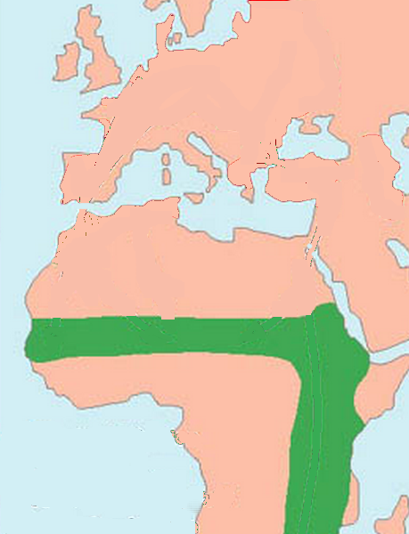
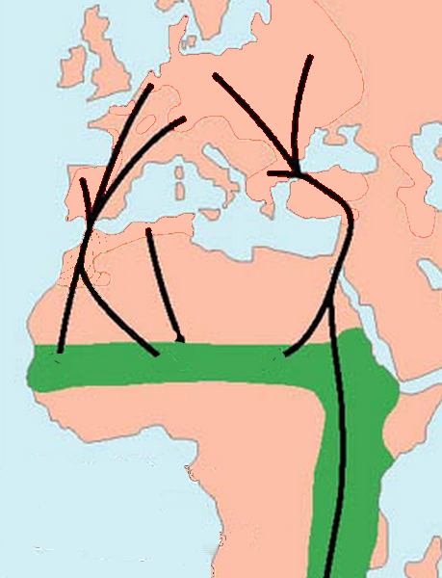
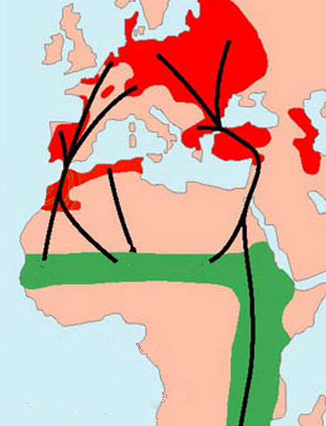
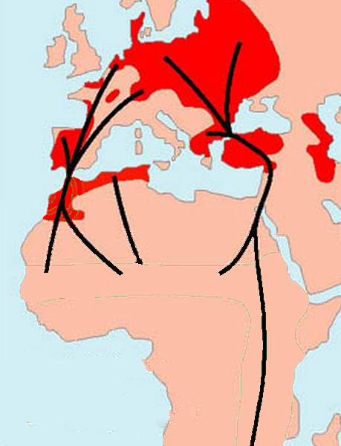
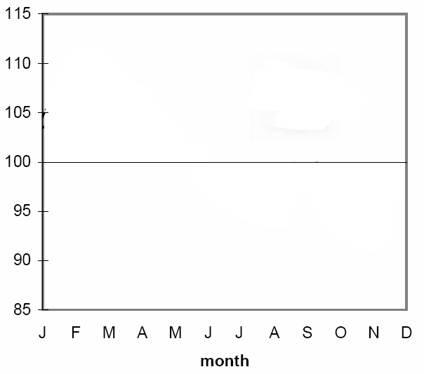
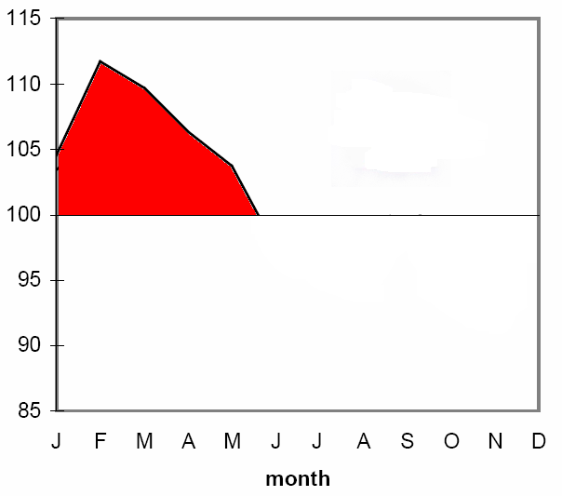
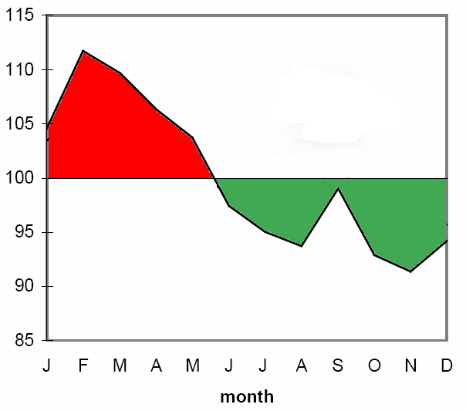
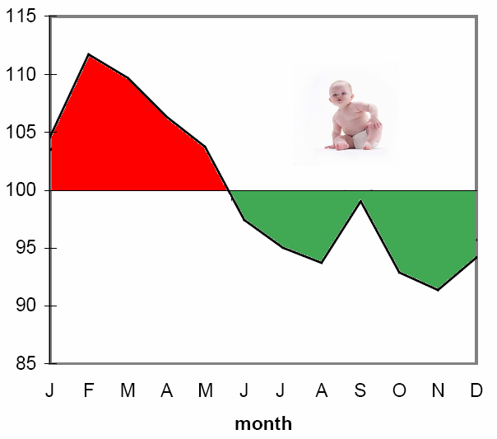

Affirming the consequent
Doblhammer et al, 1999

Slide 22
Conclusions
If you don’t want to believe in the stork, be aware of sophisms which could make you believe in it
If you want to believe in a causative role of cannabis regarding schizophrenia, don’t care about the sophism that make you believe it
If you don’t want to believe it … please be logical

Slide 23



Slide 24
http://addictohug.ch/
https://www.facebook.com/addictologieHUG/
http://www.hug-ge.ch/addictologie

