Slide 1
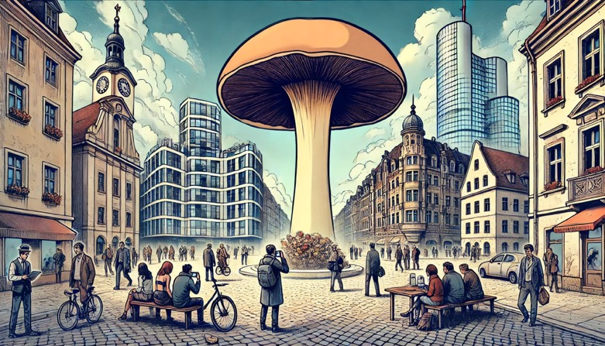


Motivational Drivers of Recreational Psilocybin Use
A Study of Social and Substance Interaction Patterns
Louise Penzenstadler
WHO collaborating center

Slide 2
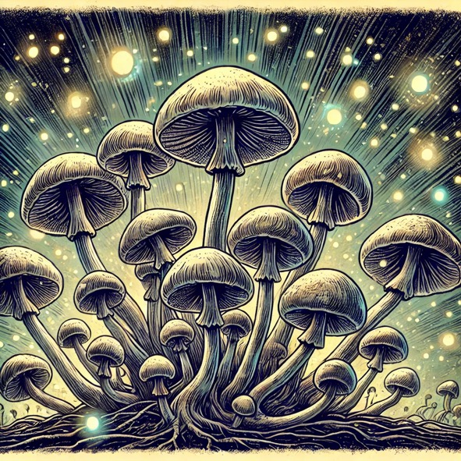
Psilocybin
Naturally occurring psychedelic compound
Produced by more than 200 species of mushrooms
Psilocybin is a prodrug
compound itself biologically inactive but quickly converted to psilocin

Slide 3
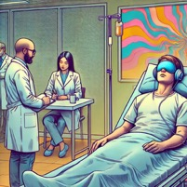
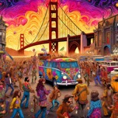





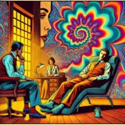

History Psilocybin
New
millennium
1960s
1957
1958
1970
Psychedelic
Renaissance
Gordon Wasson meets Maria Sabinas
Article in Life Magazine
Albert Hofmann
isolates
psilocybin
Wave of the first psychonauts travelling to Mexico
Drug Abuse and Prevention Control Act
First psychedelic era

Slide 4
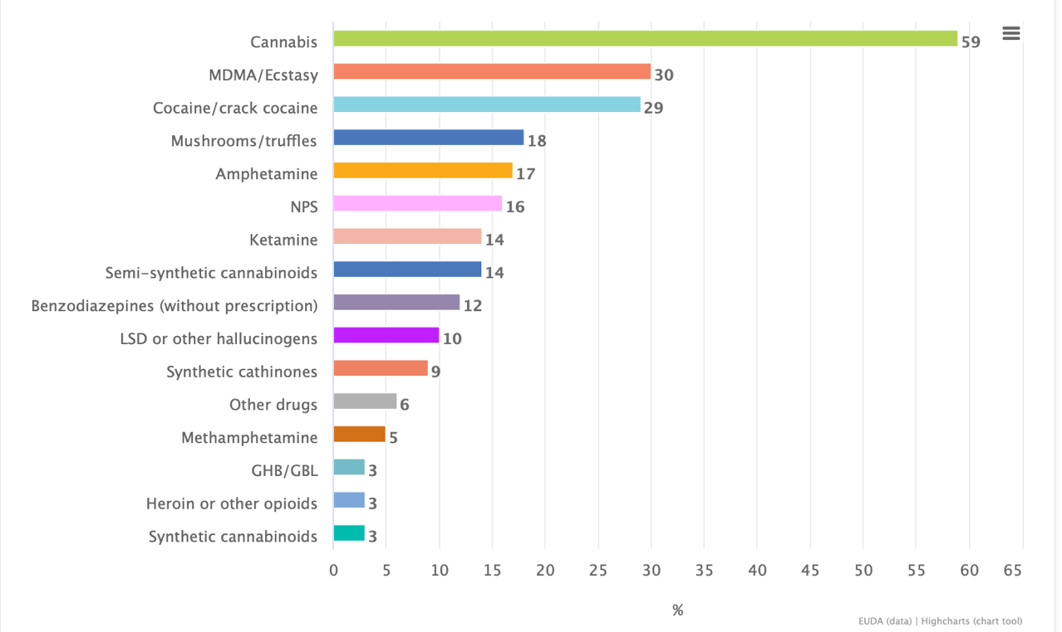

Psilocybin Use in Europe

Slide 5
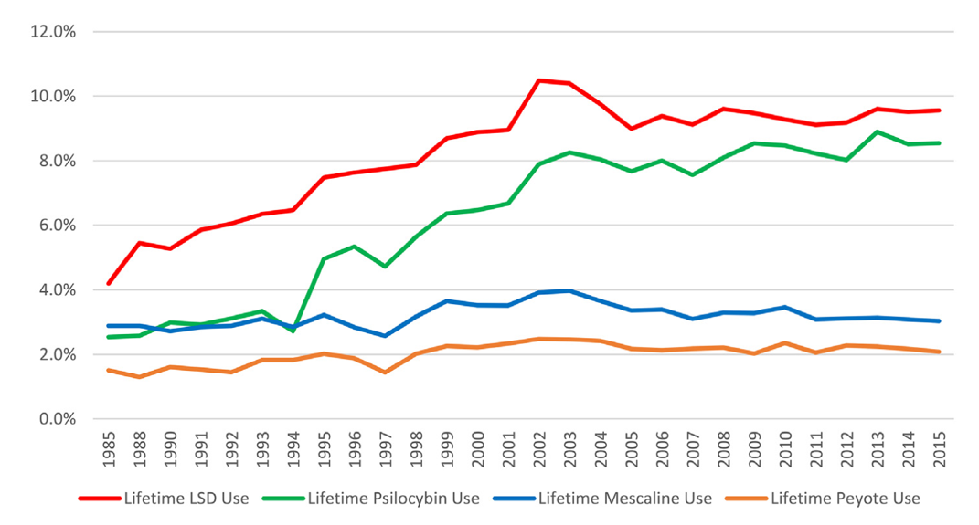

Psilocybin Use in USA
Johnson et al., 2019

Slide 6
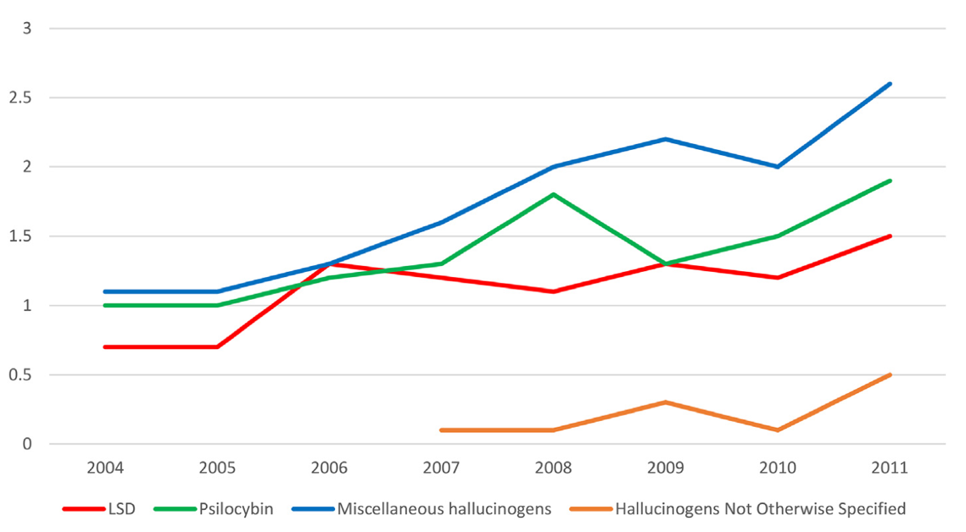
Emergency Department Visits
Johnson et al., 2019

Slide 7





Fundamental dimensions of psychedelic experiences
altered state of consciousness ASC
visionary restructuralization (VIR)
anxious ego-dissolution (AED)
oceanic boundlessness (OBN)
Pseudo-hallucinations / illusions
Synesthesia
Changes in the meaning of perceptions
Living memories
Disintegration of the self
Sense of loss of control
Sense of alienation from environment
≈ bad trip
Very pleasant state of ego expansion
Changes in the limits of the self
Experience of unity and transcendence of space and time
Sense of intuitive understanding
Elevated mood, bliss, ecstasy
Preller & Vollenweider, 2018

Slide 8
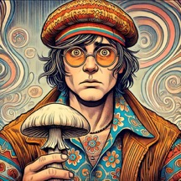

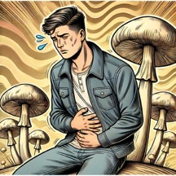
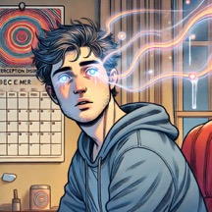
Psilocybin Risks
HPPD
Hallucinogen Persisting
Perception Disorder
Bad trip
Cardiovascular
Gastrointestinal
Fear, anxiety, dysphoria and/or paranoia
↑ heart rate and blood pressure
stomach pain, vomiting, diarrhoea
Long-term
perceptual
changes

Slide 9



Consumption motives
Ultimate factor in determining whether a product will be utilized
Proximal predictors of quantity and frequency of use
Various motivations for consumption
can also change dynamically over time
Target for prevention and treatment

Slide 10
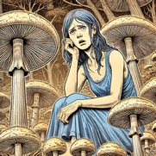
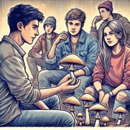

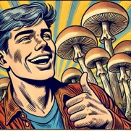

Psilocybin Motives Measure
Adapted from Dringking Motives Questionnaire and Marijuana Movites Measure
Coping
Conformity
Social
Enhancement
Expansion
to manage
stress, anxiety, or negative emotions
due to social pressure or a desire to fit in with a group
to enhance social interactions or bond with others
for pleasure, enjoyment, or sensory enhancement
for self-discovery, mystical experiences, or cognitive and perceptual expansion

Slide 11








Specific Alcohol Consumption Motives Correlated with Specific Consumption Patterns
Conformity
motives
Social
motives
Enhancement
motives
Coping
motives
Reduced
drinking
Moderate
drinking
Heavy
drinking
Alcohol-related issues
Kuntsche et al., 2005

Slide 12







Specific Cannabis Consumption Motives Correlated with Specific Consumption Patterns
Conformity
motives
Social
motives
Enhancement
motives
Coping
motives
Rather limited consumption
Consumption
Frequency
and Addiction
Cannabis-related problems
Kuntsche et al., 2005

Slide 13
Study objective
Does the use of other substances influence
Psilocybin consumption motives?

Slide 14

Methods
Web-based survey
160 participants
French, Portuguese, or English-speaking
Psilocybin use last 12 months
Socio-demographic data
Psilocybin consumption motives
Alcohol, Smoking, and Substance Involvement Screening Test (ASSIST)
Multiple linear regression analysis using the Ordinary Least Squares (OLS)

Slide 15
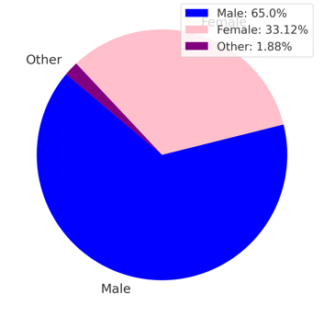
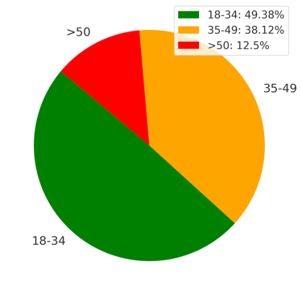
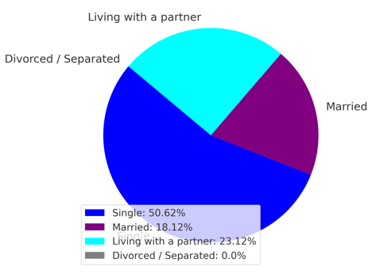
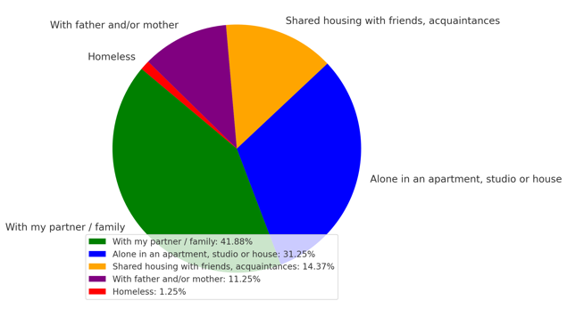
Gender
Age
Marital Status
Housing Mode

Slide 16
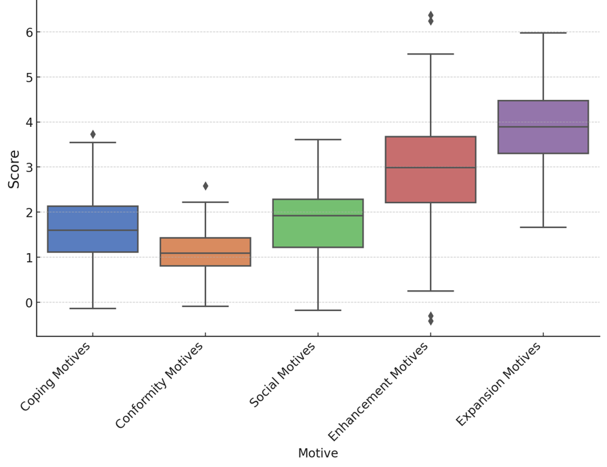
Psilocybin Motives Measure

Slide 17
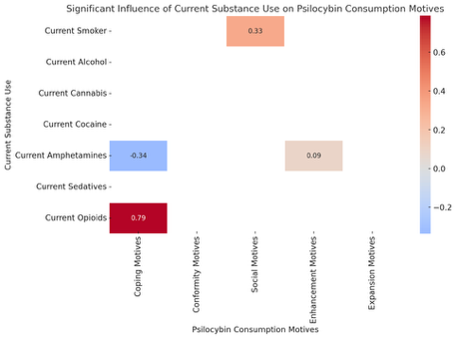
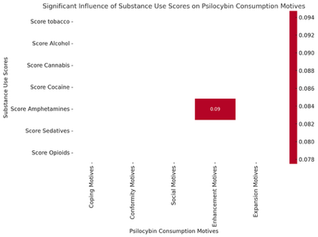
Correlation of Substance Use
and Psilocybin Use Motives
Current Substance Use
ASSIST Score
Opioid strongly associated with Coping Motives → opioid users may view psilocybin as an alternative form of emotional regulation
Amphetamine use (and especially higher use) has negative correlation with Coping Motives and positive correlation with Enhancement Motives → there may be a group of users searching sensory and experiential enhancement through different substances
Tobacco use is linked to Social Motives → smokers may in general tend to use substances to socialize

Slide 18

Take home
Psilocybin users can be grouped based on their motives, which likely reflect their broader substance use patterns.
Those using psilocybin for coping tend to consume other substances for similar emotional regulation.
Users motivated by enhancement or social interaction likely approach other substances with the same intent.

