Slide 1



Person-Centered Medicine
SUD and Psychiatric Comorbidity
Daniele Zullino
WHO collaborating center

Slide 2
SUD – Comorbid psychiatric disorders
Lifetime association of various psychiatric comorbidities and
substance-use disorder among 36,309 individuals from the US
*
*
*
Increased risk
Adjusted odds ratio
*
*
*
*
*
*
*
*
*
*
*
*
*
*
*
*
*
Decreased risk
Grant et al. JAMA Psychiatry 2016;73(1):39–47
Notes:
This study used interview data from 36,309 individuals to estimate 12-month and lifetime prevalence of substance-use disorder.^{[Grant et al., 2016]} The 12-month and lifetime prevalence of substance-use disorder was 3.9% and 9.9%, respectively.^{[Grant et al., 2016]} A significantly greater proportion of individuals with substance-use disorder had other psychiatric comorbidities compared with individuals without substance-use disorder, including major depressive disorder, dysthymia, bipolar disorder, post-traumatic stress disorder, and various personality disorders.^{[Grant et al., 2016]} The findings show the broader costs of substance-use disorder, and highlight the need to destigmatize the condition to enable people to come forward for treatment.^{[Grant et al., 2016]}
Reference:
Grant BF, Saha TD, Ruan WJ, et al. Epidemiology of DSM-5 drug use disorder: results from the National Epidemiologic Survey on Alcohol and Related Conditions – III. JAMA Psychiatry 2016; 73 (1): 39–47.

Slide 3
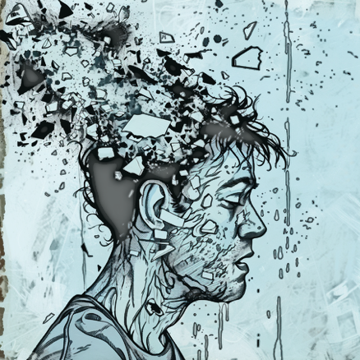
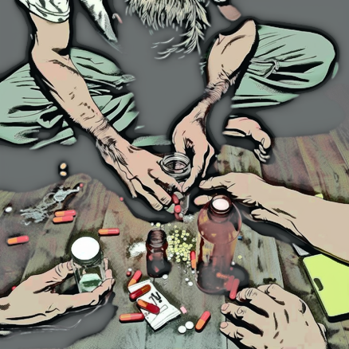
Psychiatric
disorders
Addictive
disorders
Increases
probability

Slide 4

Addiction and Mental Disorders
Two things? Two domains?

Slide 5


Slide 6


Slide 7

Academic Discipline
Characterized by
  a specific domain
  a specific terminology
  specific methods, approaches and techniques of analysis
  specific ways of thinking and perceiving the investigated phenomena
Has a curriculum
Has ad hoc research program
Has a theoretical framework

Slide 8
Discipline and paradigm
The term paradigm proposed by American historian of science, Thomas Kuhn
A way of seeing or a method to be followed to define the set of principles and methods shared by a scientific community
A model of understanding that is be authoritative at least for a period of time
Has a normative and stabilizing function and shapes the orientations and the reference framework of a scientific community
It is through paradigms that disciplinary traditions are constituted
Thomas Kuhn (1922-1996)

Slide 9


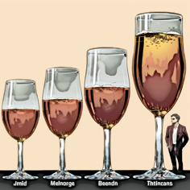
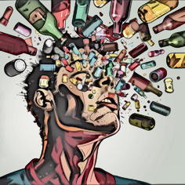
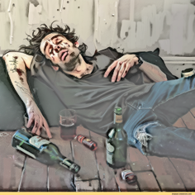
Dependence
Addiction
Tolerance
Withdrawal
Central syndrome
addictive behavior
Secondary syndrome
consequences
little variance
little variance
much variance

Slide 10
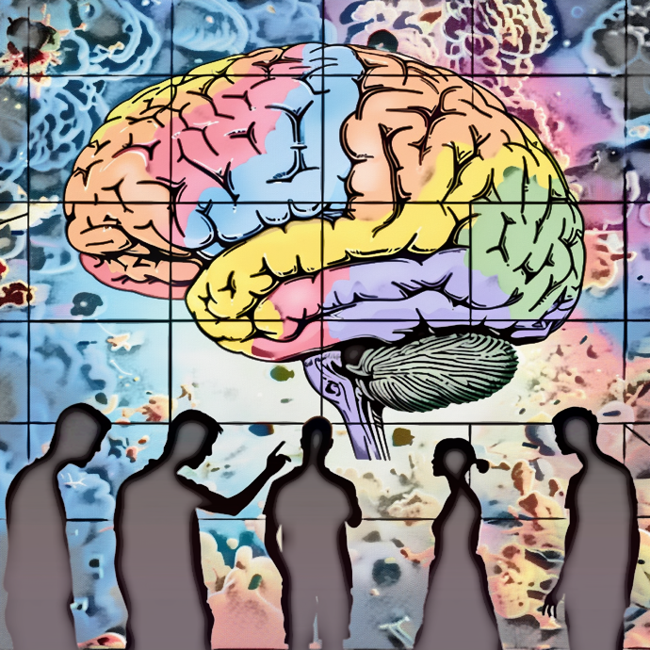
The addiction paradigm
Central syndrome constitutes the main subject of the discipline, its raison d'être
Paradigm of addiction medicine is constituted around concepts that are mainly
  behavioral (inability to abstain, behavioral control disorders)
  experience-related
    cognitive (irrepressible appetite to consume, difficulties in recognizing problems related to consumption behaviors)
    emotional
The description of the phenomenon “addiction” uses of a psy-terminology
Therapeutic approaches are mainly psychiatric and psychotherapeutic

Slide 11




Objectives of addiction medicine
Abstinence
Where
to
go?
Harm
reduction

Slide 12


Addiction
Recovery
Neural reorganization
Neuroplasticity
Psychotherapy
Monopolizing
cognitivo-behavioral
attractors
Re-developing
possible selves

Slide 13
Mental Disorder
Addiction
Recovery
Neural reorganization
Neuroplasticity
Psychotherapy
Monopolizing
cognitivo-behavioral
attractors
Re-developing
possible selves

Slide 14

Conclusions
Addiction medicine is paradigmatically psychiatric
  Institutional separation nonsensical
    An unfortunate tradition, which confuses addictive behavior with its consequences

