Slide 1
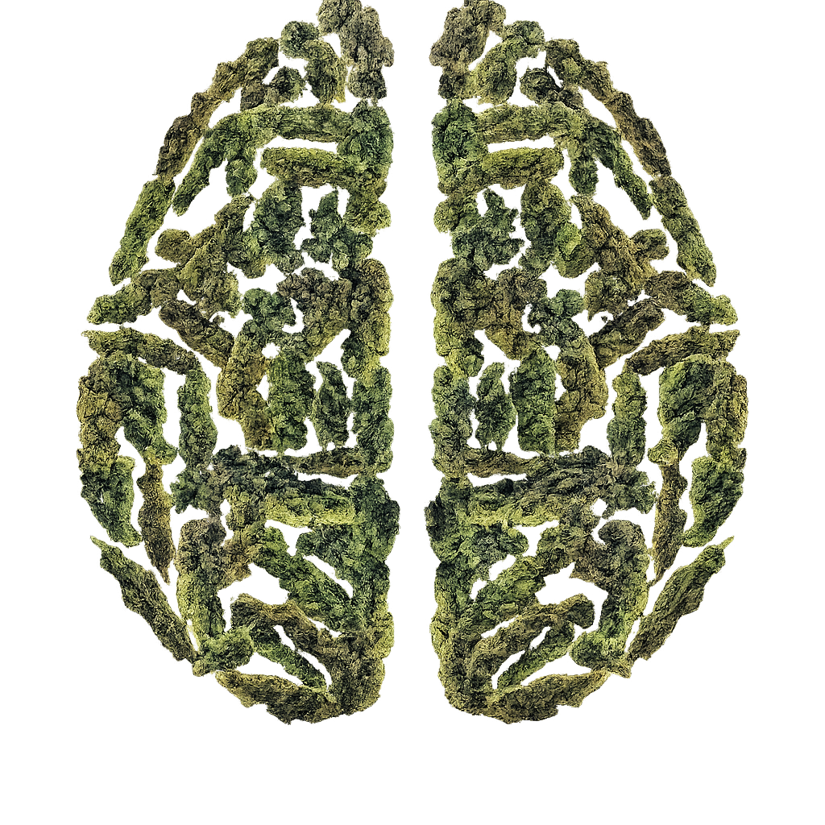
NfL and GFAP Quantification
Associations with Mental Health in Recreational Cannabis Users
Maximilian Meyer
UPK Basel
Swiss Addiction Research Day, 13.03.2026

Slide 2


Cannabis & Cognitive Impairment
Acute Effects
Reduced concentration
Slower decision-making
Reduced working memory
(Crean et al., 2011)
Long-term Effects
Mean IQ decline (5.5 points)
Memory and attention deficits
Smaller hippocampal volume
(Meier et al., 2022)
Notes:
Why is this interesting?
Meier et al. study: follow-up of cohort (n=1037, New Zealand), IQ tests at age 7, 9, 11, and 45: average -5.5 IQ in long term cannabis users

Slide 3
Why does Cannabis Impair Cognition?
Three Competing Hypothesis (Bourque & Potvin, 2021)
Cognitive Vulnerability
Pre-existing cognitive deficits increase risk of regular use
Concurrent
Short-term associations only (when controlling for pre-morbid function)
Neurotoxicity
Long-term impairment persists even after stopping use
Notes:
Dichotomy in public perception: cannabis as illegal drug vs. cannabis as medical product used to treat illnesses

Slide 4
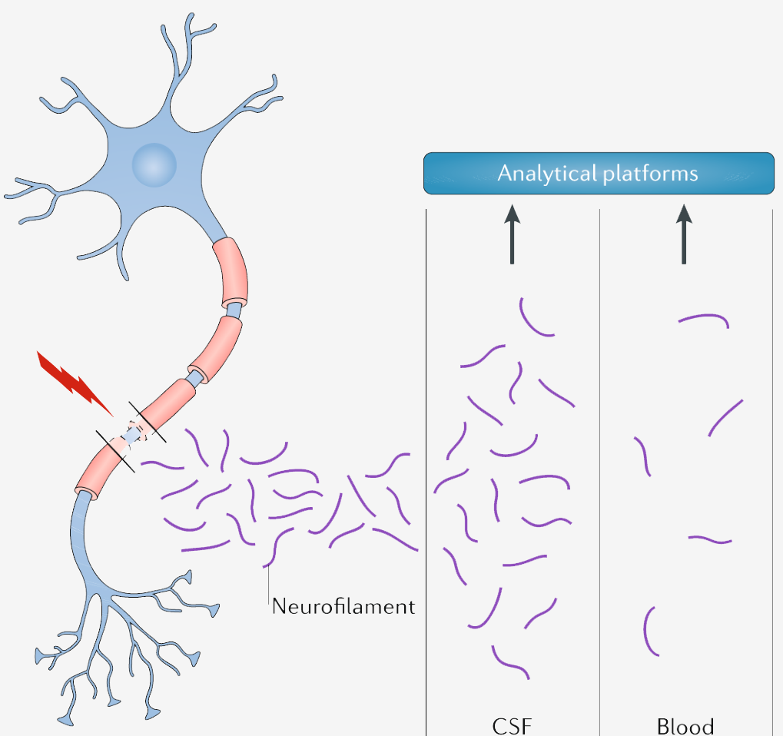
Biomarkers: NfL and GFAP
Neurofilament Light Chain (NfL)
Scaffolding protein in neurons
Marker of neuronal damage
Associated with brain volume loss
Elevated in psychiatric & neurological disorders
Found elevated in alcohol and cocaine use
(Benkert et al., 2022; Chen et al., 2022)
Glial Fibrillary Acidic Protein (GFAP)
Expressed in astrocytes
Marker of astroglial injury / activity
Associated with cognitive decline
Inconclusive findings in psychiatric disorders
(Khalil et al., 2018)
(Hviid et al., 2023, Steinacker et al., 2021)
Notes:
GFAP: maintains cell shape of astrocytes and thereby supports metabolism of neurotransmitters and maintenance of blood brain barrier. Upregulation during astrogliosis (astrocyte reaction to CNS injury, inflammation, or disease)
NfL (Neurons) and GFAP (Astrocytes): markers for disease progression in multiple sclerosis
Levels of both vary across individual factors (age, BMI and for GFAP biological sex)

Slide 5

Research Gap
No studies exist on NfL/GFAP levels in cannabis users
Our Study Aims:
Quantify sNfL and sGFAP levels in recreational cannabis users
Investigate associations with CUD symptoms and mental health

Slide 6


Methods
Sample: WeedCare Study Participants
n = 331 recreational cannabis users
Blood samples + validated questionnaires (+ information on biological sex) collected
Assessments
Cannabis Use Disorder (CUDIT-R)
Anxiety (GAD-7), Depression (PHQ-9), Psychosis (ERIraos), ADHD (ASRS-V1.1), Alcohol use (AUDIT-C)
Serum NfL and GFAP
→ Age-, BMI-, and sex-adjusted Z scores

Slide 7
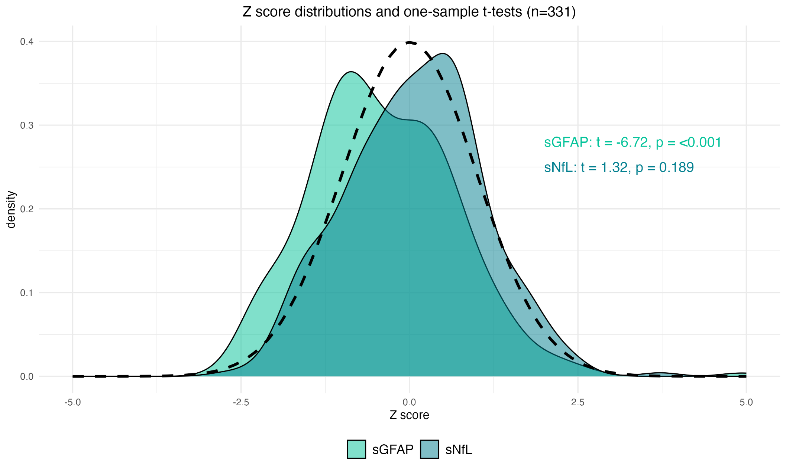
Results
GFAP Levels
Significantly lower (p < .001)
NfL Levels
No difference from reference

Slide 8
Results: NfL
Positive correlation:
  CUDIT-R score x NfL Z score (rho = .12, p = .03)
  ERIraos score x NfL Z score (rho = .08, p = .008)
Group Differences by Psychometric Cut-offs:
Assessment | Finding | Effect
CUDIT-R ≥8 (hazardous) | Higher NfL | p = .028*
ERIraos ≥1 (psychosis) | Higher NfL | p = .005**
Depression, Anxiety, ADHD | No association | n.s.
* p < .05 ** p < .01
Notes:
hazardous use: score ≥ 8; possible CUD: score ≥ 13
Also: positive correlation of CUDIT-R score and sNfL levels

Slide 9
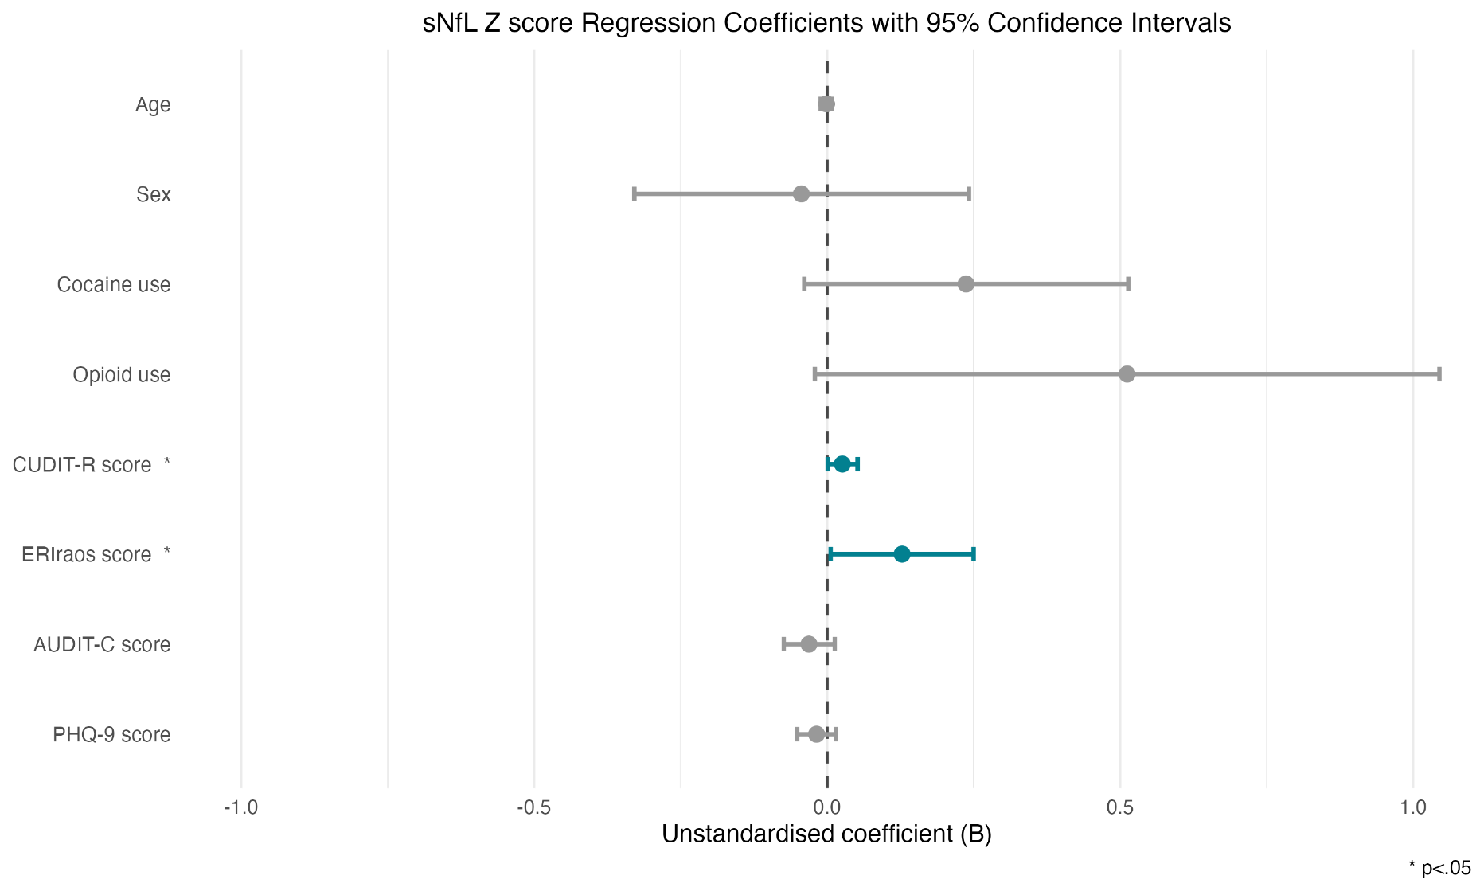
Results: NfL
Specific CUDIT-R items
associated with NfL:
Memory/concentration problems
(ρ = .11, p = .04)
Time spent buying/using/recovering
(ρ = .13, p = .02)
Notes:
ERIraos and CUDIT-R score predicted sNfL z-score

Slide 10
Results: GFAP
Lower GFAP levels overall compared to reference population (p < .001)
Group Differences by Psychometric Cut-offs:
Assessment | Finding | Effect
ERIraos ≥1 (psychosis) | Lower GFAP | p = .047
All other assessments | No association | n.s.
No variable significantly predicted GFAP levels in the linear regression model

Slide 11


Results: Summary
Independent predictors of higher NfL Z scores:
ERIraos Score
(Psychotic Symptoms)
CUDIT-R Score
(Cannabis Use Disorder)
Specific CUDIT-R items associated with NfL:
Memory/concentration problems (ρ = .11, p = .04)
Time spent buying/using/recovering (ρ = .13, p = .02)
GFAP Findings: Inconclusive and no associations with cannabis use

Slide 12

Interpretation
Memory/concentration problems linked to NfL may reflect neurotoxic effects of THC
Early evidence for neurotoxicity hypothesis:
Elevated NfL associated with CUD severity
Specific link to self-reported cognitive problems
Consistent with findings in alcohol and cocaine use
BUT
Limitations
Cross-sectional design
No objective cannabis measurement
Weak effect size (ρ = .12)
Notes:
Longitudinal studies are needed with objective THC measurements. Effect size is very weak and NfL is an unspecific marker. GFAP remains inconclusive.

Slide 13



Study Team
Maximilian Meyer
Jens Kuhle (Uni Basel)
Lavinia Baltes (WeedCare/PDAG)
Marc Walter (WeedCare/PDAG)
Marc Vogel (UPK Basel)
Study physicians: Adrian Guessoum, Felix Mosandl, Oliver Hermann (all UPK Basel)
addictionresearch.ch
maximilian.meyer@upk.ch

