Slide 1
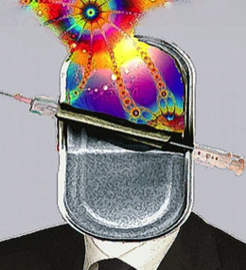


The Healthy Clash Between Caregivers and Artists - Or How to Reintroduce Heuristic Approaches Into Addiction Medicine
Daniele Zullino, Rita Manghi, Gabriel Thorens, Stéphane Rothen, Francisco Gonzalez Casanova,
Michèle Lechevalier and Marie-Antoinette Chiarenza
Submission Number: 34492
WHO collaborating center

Slide 2
Art / Psychiatry
Arttherapy
Promoted artistic expression of patients ➛ therapeutic
    e.g communicate the patient's internal state, catharsis
    Being exposed to art ➛ therapeutic
    e.g. illustration, psychoeducation
Self-therapy through being an artist
The artist’s suffering as a motive/motivation for artistic expression
Art critics: analyzing work of an artist as an expression of his illness

Slide 3
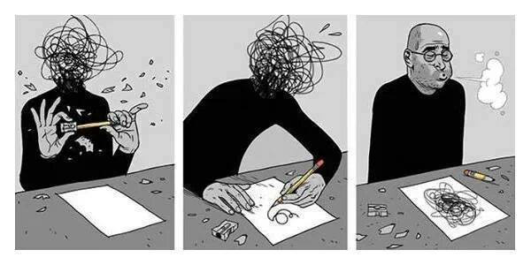
Art / Therapy
Objective of most projects
http://www.asafhanuka.com/the-realist/#/viral/

Slide 4
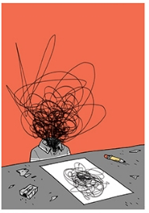
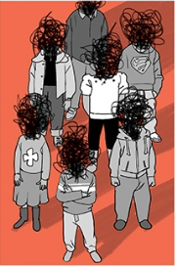
Art / Therapy
Objective of our project
http://www.asafhanuka.com/the-realist/#/viral/

Slide 5
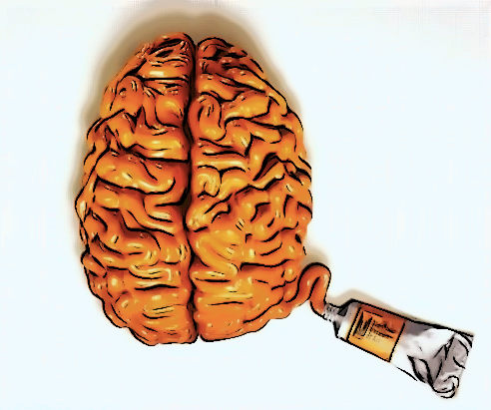
Art ↔︎ Psychotherapy︎
Psychotherapy
Art

Slide 6

Artworks
Draw our attention to the essentials
they omit, densify
simplify
Obstretricians of thoughts
Alain de Botton, 2002

Slide 7
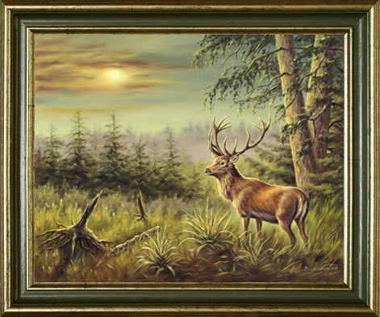
Bad art
a series of bad decisions on what should be retained and what should be omitted
Alain de Botton, 2002

Slide 8
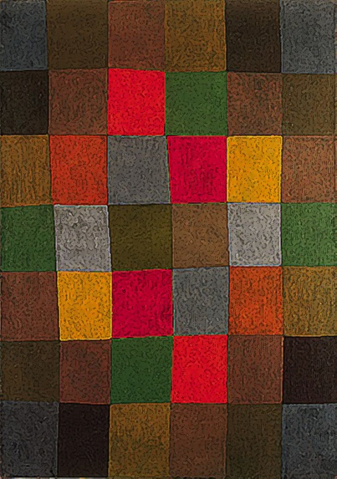
Making order
Life ≈ disorder
Humans have a preference for order
Art puts order, structure
  Satisfies a need, that reality does not satisfy
Aristotle: art is an improvement of reality
Ex: Novel, Biography vs 'real life'

Slide 9
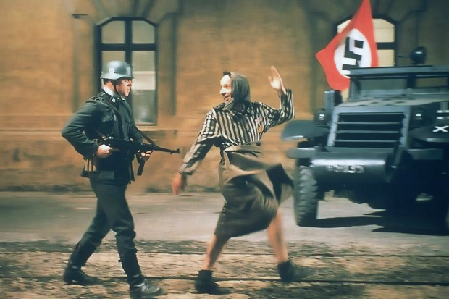
Catharsis
Purification / purge of emotions
  Pity, terror
  Testimony of tragedy
E.g. classical theater, melodramatic movies
       management of the adversities of life at a "safe distance"

Slide 10
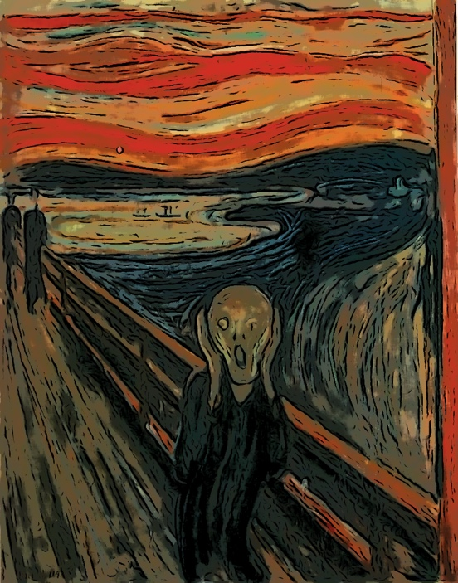
Communication
  Communication of things that can not be communicated otherwise?
  Success of art  Successful communication
Absolute music, abstract art, surrealist poetry: Communication of emotions ?

Slide 11
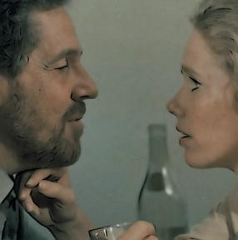
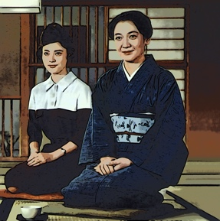
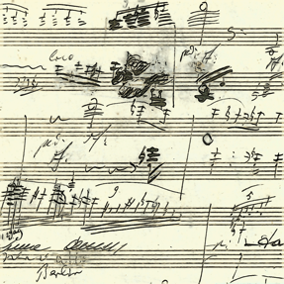
‘Education’
Novels, movies etc. teach on social interaction
Visual arts on other places, people, things
Poetry and music on the emotional

Slide 12
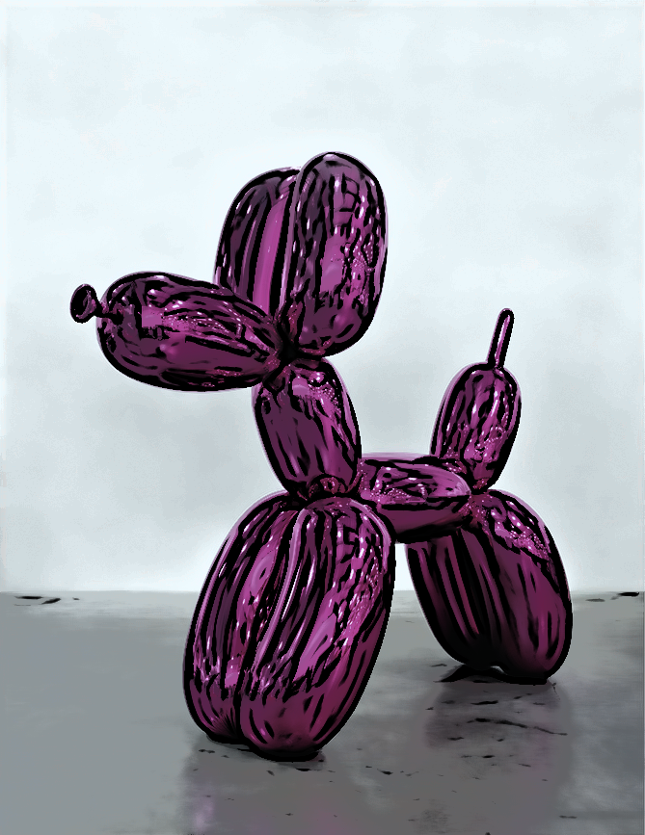
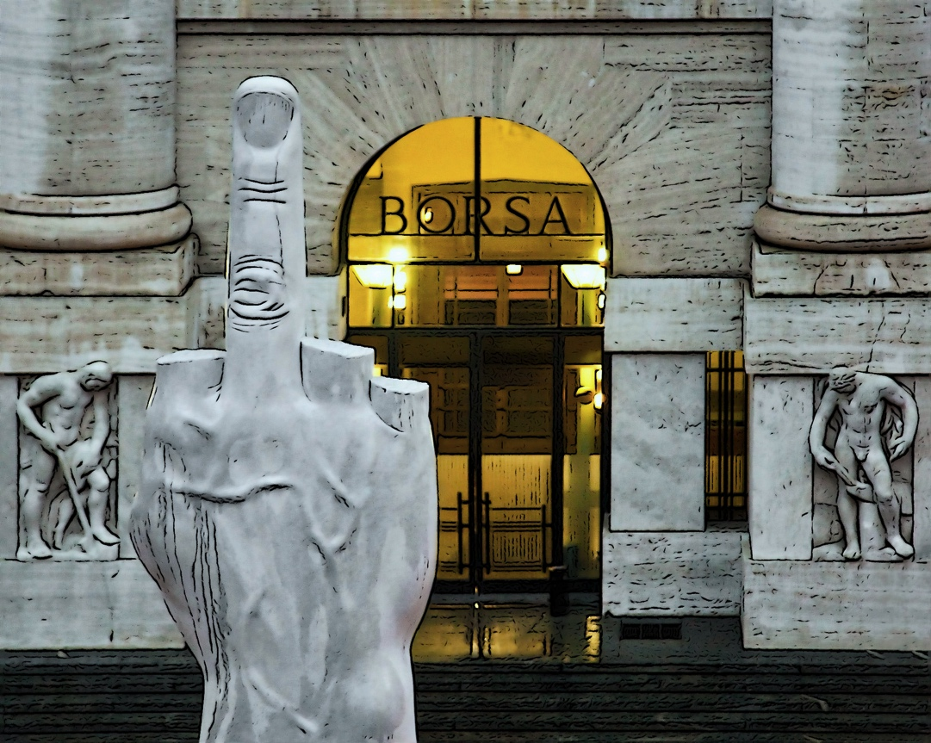
Entertainment

Slide 13
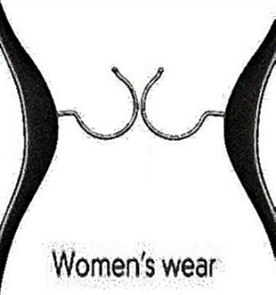
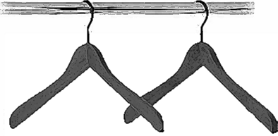
Creativity
Standard arrangement of constituent elements
New arrangement
creative
process
emergence
Different properties of the elements

Slide 14
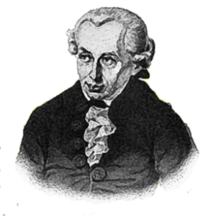
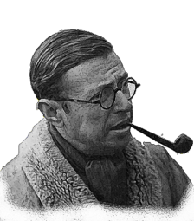
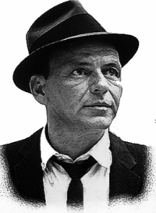
To be, is to do
Kant
To do, is to be
Sartre
Do be do be do
Sinatra

Slide 15
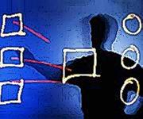
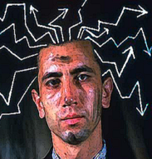
Intelligence
Creativity
Convergent thinking
Divergent thinking
Search for THE correct and certain answer
Search for NEW answers
Most creative people rather smart,
But intelligent people not necessarily creative

Slide 16
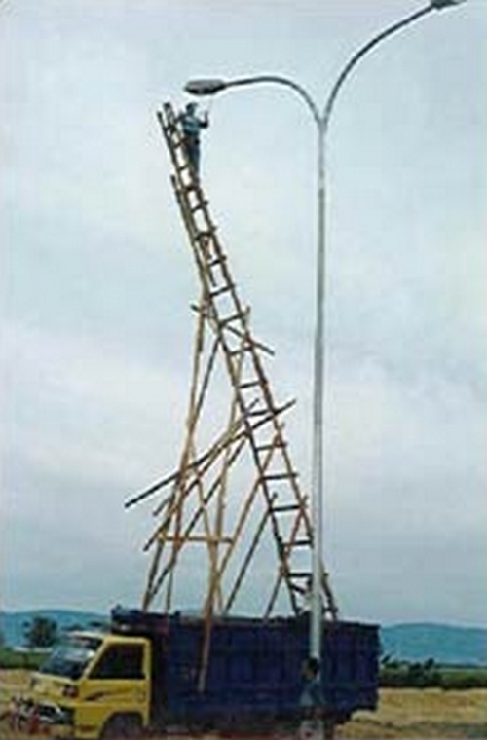

Slide 17
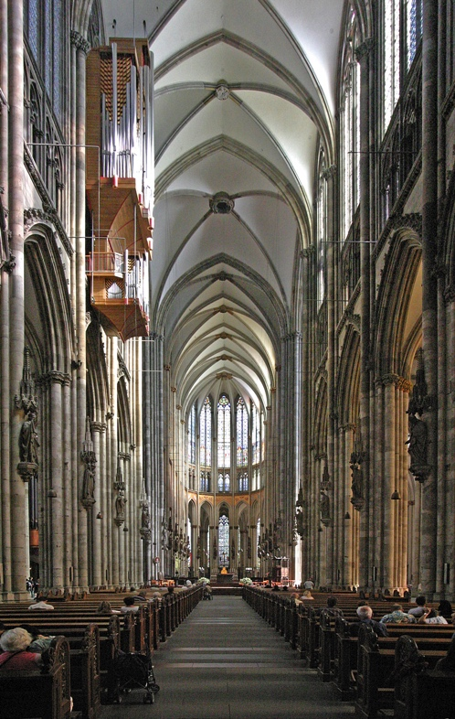
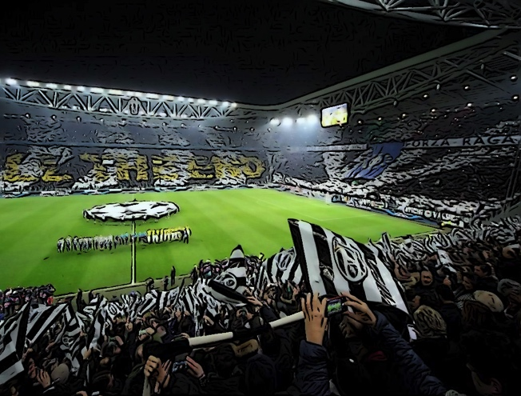
Environment largely determines what we are capable to believe

Slide 18
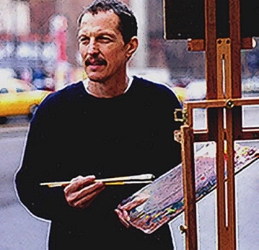
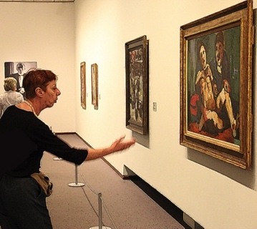
Effect of art
Ability to change the view
of the artist
of the spectator

Slide 19
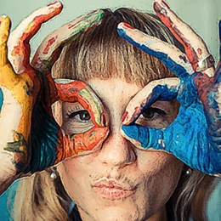
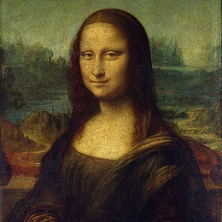
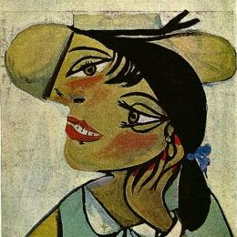
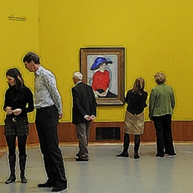
Perception of art
allows new interpretations and the generation of new meanings
artist
cultural tradition
public

Slide 20
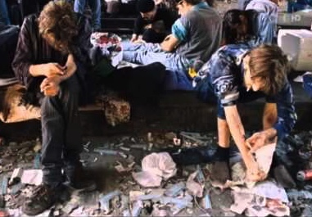
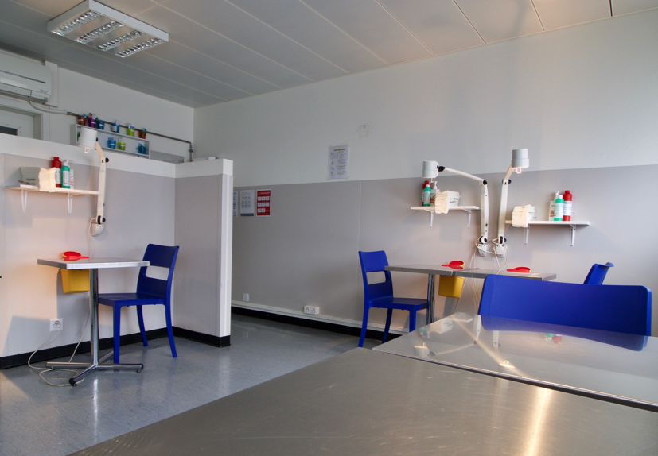
Mission
90s
new millenium
Helping to survive
Helping to live

Slide 21
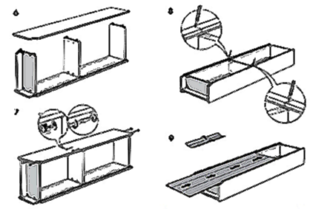
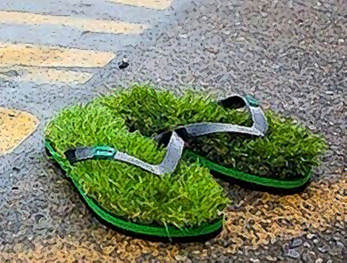
Algorithmic tasks
Heuristic tasks
  Follow a set of established instructions
      down a single pathway
          to one conclusion
  Routine work
      easily outsourced or automated
  No algorithm exists
      experiment with possibilities
      devise new solutions
  Creating something the world didn’t know it was missing
Pink, 2009

Slide 22
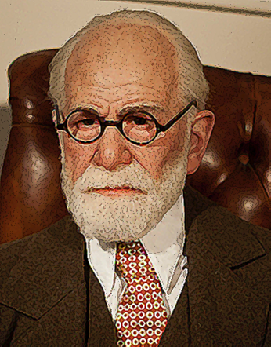
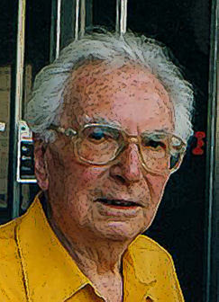
Psychology of heights
Humans attracted towards a meaning
Psychology of the depths
Humans driven by impulses
Sigmund Freud
Viktor Frankl

Slide 23
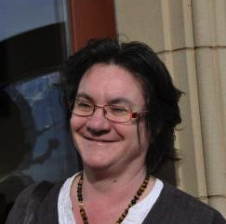
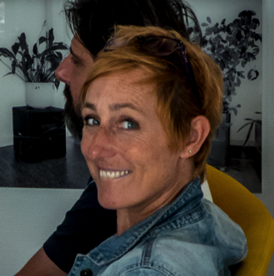
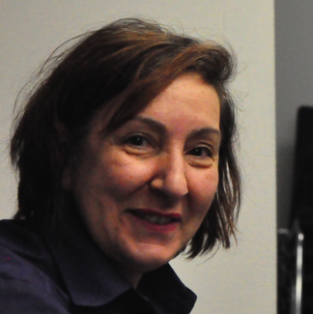
The project
Division of Addiction Psychiatry
Rita Manghi
Cultural Affairs of the hospital
Michèle Lechevalier
Geneva School of Art and Design
(HEAD – Genève)
Marie-Antoinette Chiarenza

Slide 24
The project
1 masterclass
Atelier in residency (Jungle houhouHaHa-room)
Interactions
participation of artists to therapeutic activities
patients’ integration into projects
  e.g. soap opera, DSM-5 color codes
  therapies in the Jungle houhouHaHa-room
  temporary and permanent artworks

Slide 25



Interactions
artists
caregivers
patients

Slide 26
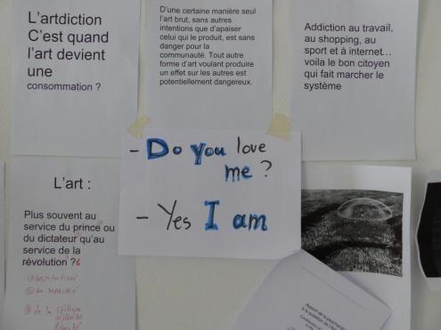
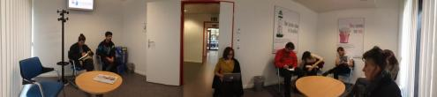

Slide 27
Metaphors
μεταφορά (metaphorá) = transport
Linguistic figure, based on analogy and / or substitution
Transposition of word/phrase from a customary context to a new domain
Transgression of ordinary use of terms and combinations

Slide 28
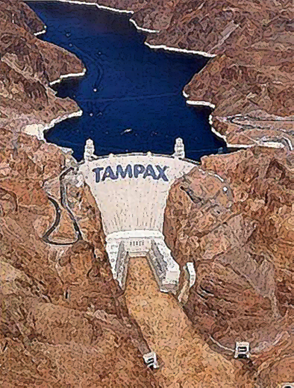

Slide 29
Utility metaphors
"Friction" between two semantic realities
‘emotionalize’, shock
perturb, upset, and reorganizes knowledge
effect is proportional to the felt surprise
creative tensions
vivification theories

Slide 30
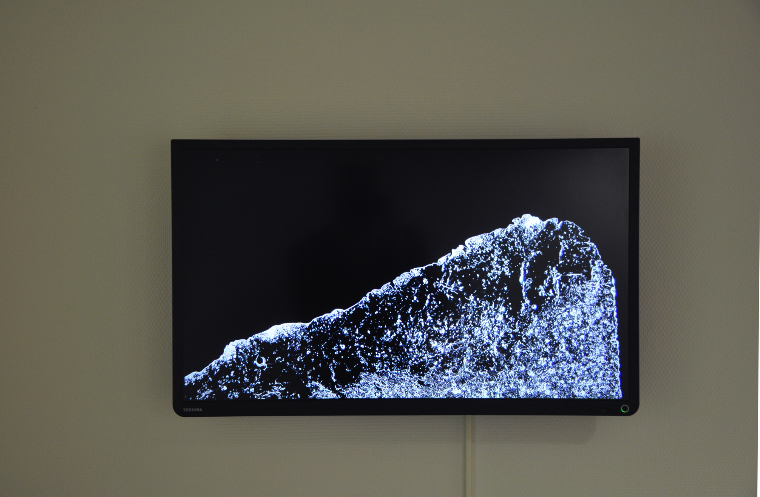

Slide 31
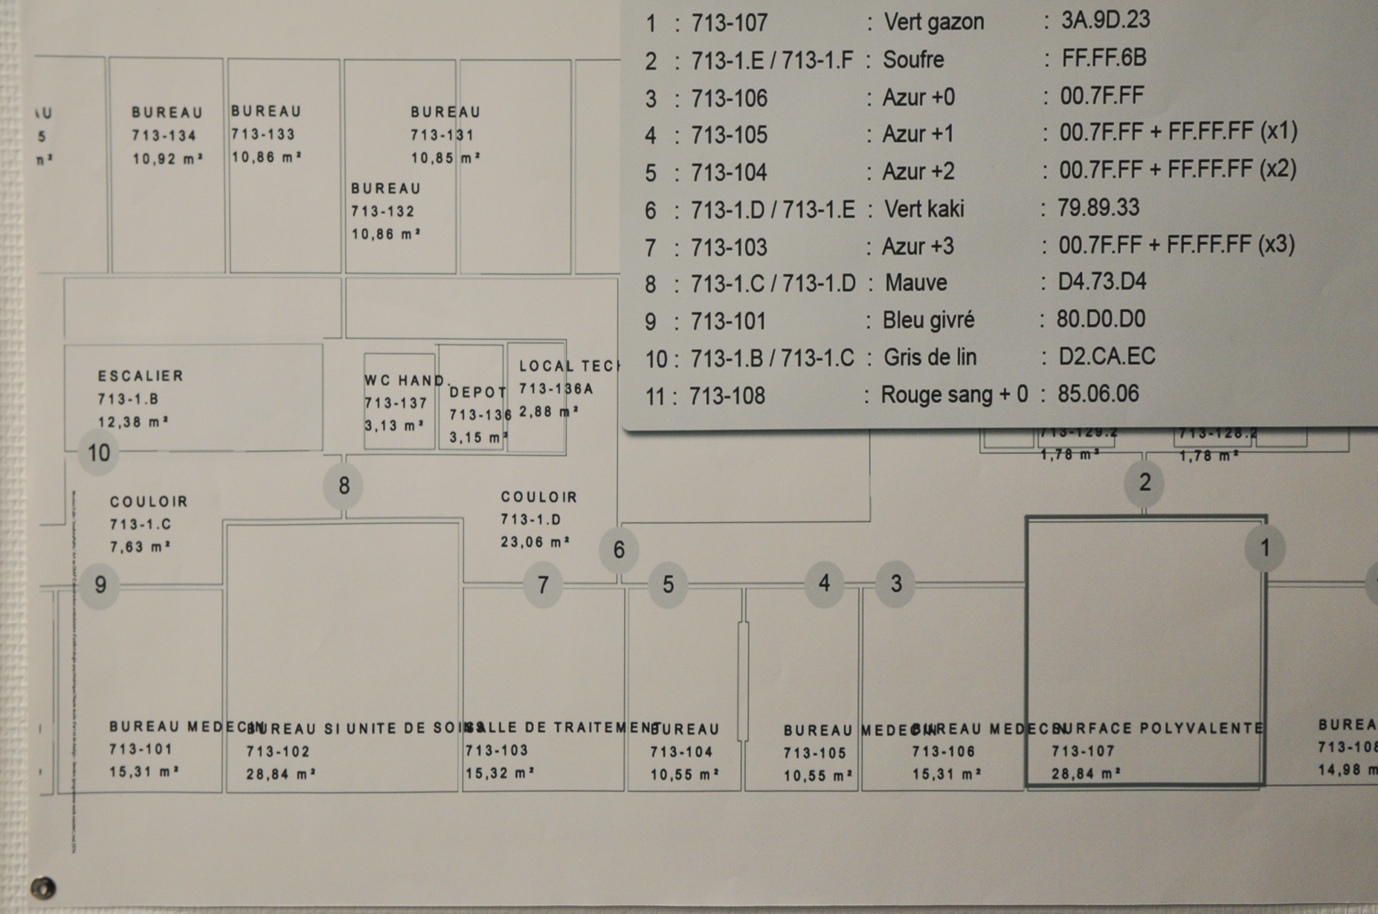

Slide 32


Slide 33
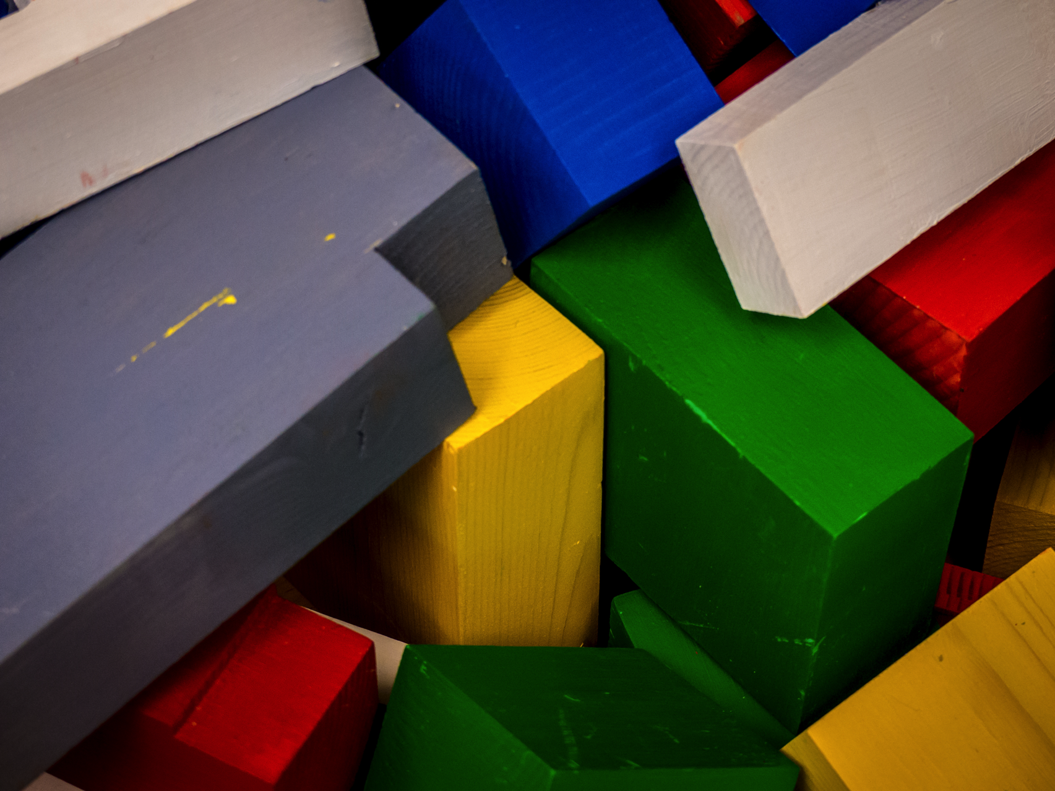

Slide 34


Slide 35
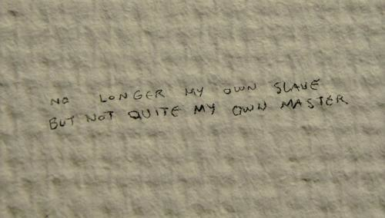

Slide 36
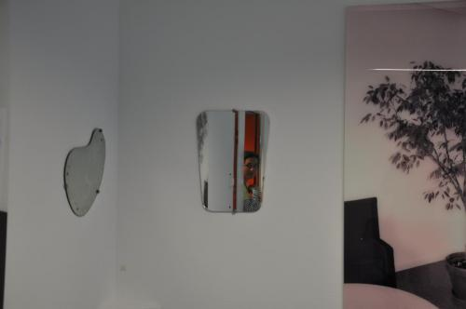

Slide 37
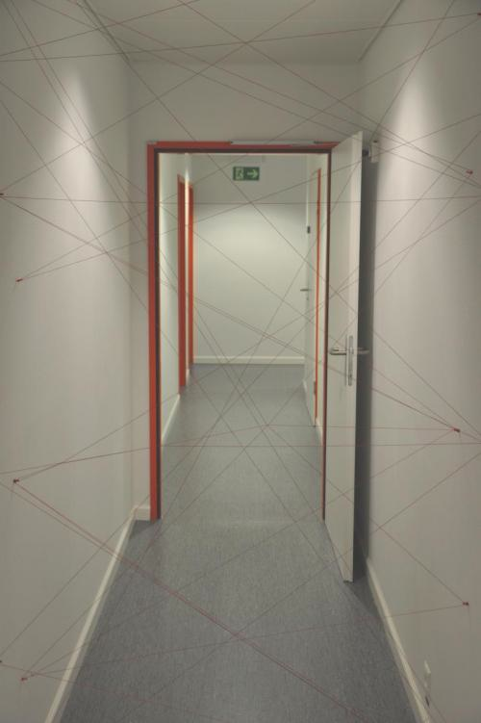
Notes:
Ariane's Thread:

Slide 38
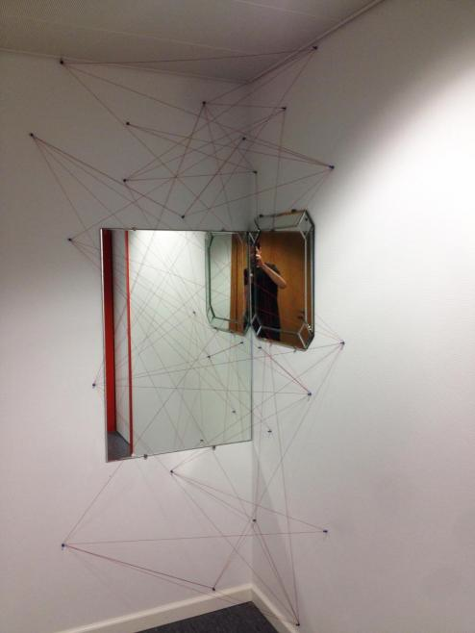

Slide 39






http://addictohug.ch/
https://www.facebook.com/addictologieHUG/
https://twitter.com/addictologiehug
https://www.linkedin.com/company/service-d'addictologie
https://www.youtube.com/channel/UCVhK2ZmXqSqWqR3rtgGHvpA/videos
http://www.hug-ge.ch/addictologie

