Slide 1



Mental Health Predicts Cannabis Use: Motivational Pathways Revealed
Daniele Zullino, Louise Penzenstadler, Tamara Corino, Maelle Bisson, Tatiana Aboulafia Brakha, Sandro Cattacin
WHO collaborating center

Slide 2


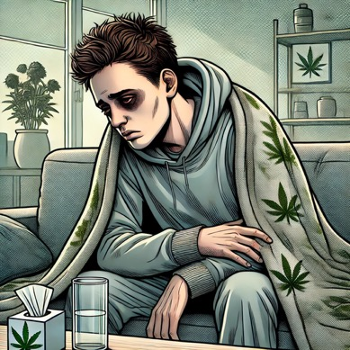
Cannabis Use
Health Issues

Slide 3

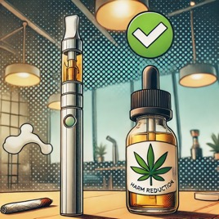
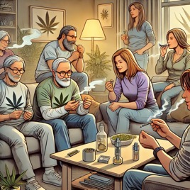
Abstinence
Harm Reduction
Consumption competence
Acceptability

Slide 4

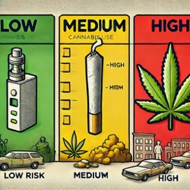

Consumption motives and harm reduction
Tailored
Interventions
Risk
Differentiation
Acceptability of policies and programs

Slide 5
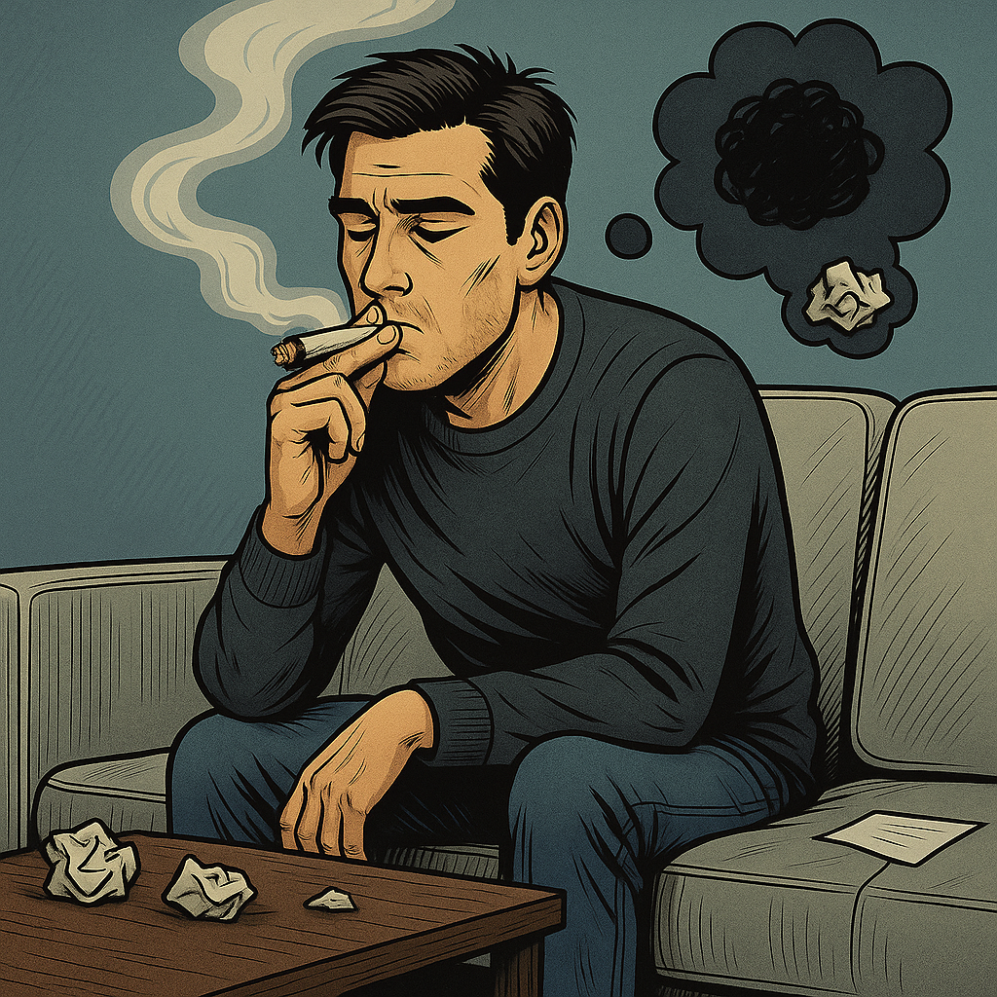
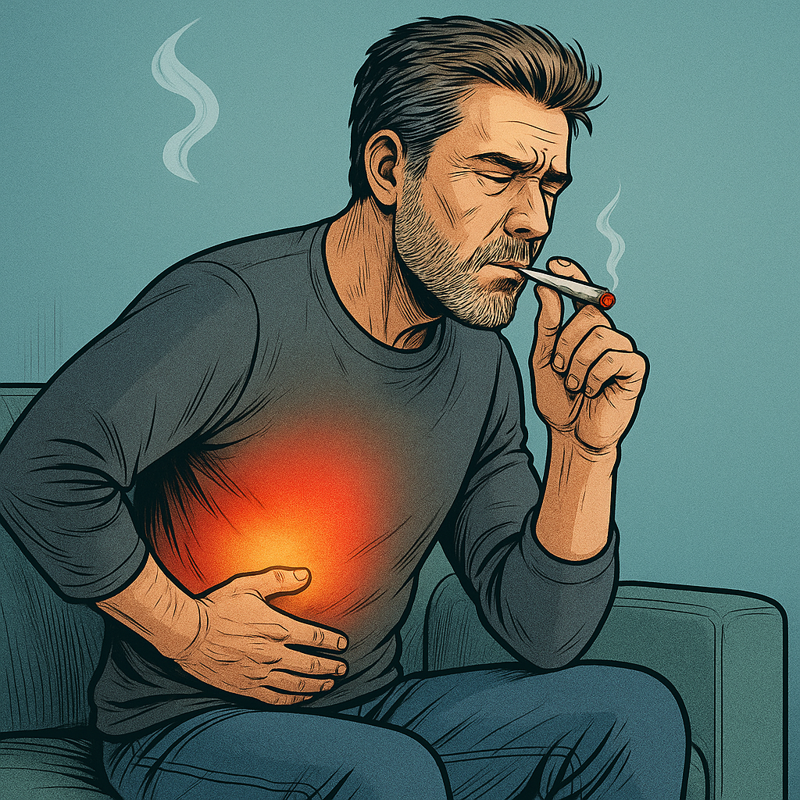
Coping Motives, Health and Cannabis Use
Coping strongest predictors of cannabis-related problems
Use chronic pain one of the most commonly reported reasons for medical cannabis use
Chronic pain users reported fewer cannabis use problems
Severity of pain did not correlate with increase in cannabis-related problems
Bresin and Mekawi, 2019; Schultz et al., 2019; Glodosky and Cuttler, 2020; Blevins et al., 2016; Genrich et al., 2021; Scarfe et al., 2022; Sznitman et al., 2022; Bonn-Miller et al., 2007; Guillot et al., 2018; Short et al., 2022; Metrik et al., 2016; Elsaid et al., 2023; Bakhshaie et al., 2020; Lehman et al., 2023; Hernandez and Levin, 2022; Marshall et al., 2020; Morris et al., 2024; Hartmann and McLeish, 2022; Schultz et al., 2023; Cohen et al., 2016

Slide 6
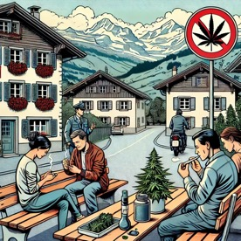

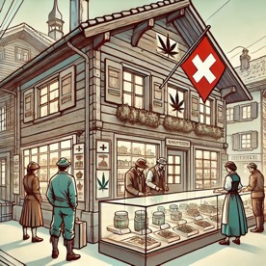
Swiss context
Despite prohibition, cannabis consumption remains widespread in Switzerland
Swiss Parliament passes amendment to the Narcotics Act September 25, 2020
Allows scientific pilot trials
cannabis for recreational purposes
intended to run for a decade
to provide scientific insights that could inform future legislation

Slide 7

La Cannabinothèque
Geneva pilot project
Launched in December 2023
Approved by Geneva Cantonal Ethics Commission and Federal Office of Public Health
Locally, and organically grown cannabis,
Controlled THC levels
Also serves as an educational center promoting awareness about cannabis effects and risks

Slide 8
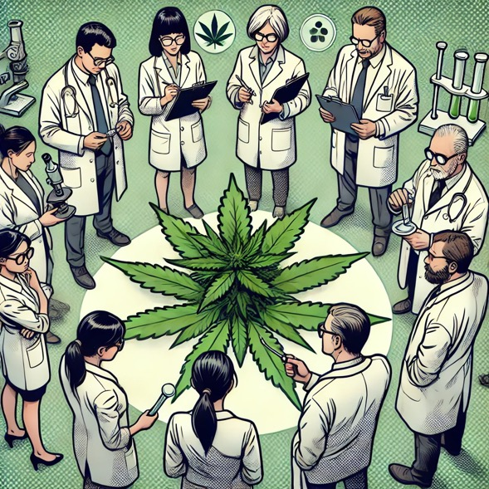
La Cannabinothèque
Study evaluates
changes of cannabis consumption
effect on consumption of other substances
shifts in public health metrics
socio-economic implications
impacts on local crime rates and illegal market
participant satisfaction and perceptions of safety

Slide 9

Longitudinal cohort study spanning 3 years
Present analysis: baseline survey of first 696 participants
Information on demographics, health status, cannabis consumption patterns, and attitudes towards regulated cannabis access

Slide 10






Short Form-20 Health Survey (SF-20)
Physical Functioning
Role Functioning
Social Functioning
Mental Health
Health Perceptions
Pain

Slide 11





The Marijuana Motives Measure (MMM)
Coping
to cope with stress, anxiety, or negative emotions
Social
in social settings to enhance interactions or to bond with others
Expansion
to intensify experiences, creativity, or perceptual changes
Conformity
to fit in with peers or meet social expectations
Enhancement
for pleasure or to enhance positive emotional states

Slide 12











Path analysis
SF-20
MMM
Physical Functioning
Coping
Role Functioning
Social
Social Functioning
CUDIT
Expansion
Mental Health
Conformity
Health Perceptions
Pain
Enhancement
start variables
mediator variables
end variable

Slide 13
Direct effects
SF-20
Physical Functioning
0.0081
Role Functioning
0.0064
Social Functioning
-0.0048
CUDIT
Mental Health
-0.1143***
Health Perceptions
-0.0088
Low mental health associated with higher cannabis use disorder scores
0.0092
Pain

Slide 14
Path analysis
Coping
0.303
−0.378
Conformity
−0.159
Mental Health
−0.104
Social Functionning
CUDIT-R
0.083
− 0.157
Enhancement
Social Functionning
−0.131
Expansion
Mental health is a central predictor of problematic cannabis use
Coping motives (using cannabis for emotional regulation or coping) are the key mediating mechanisms

Slide 15

Harm Reduction Strategies: Three Pathways
Improving mental health to reduce coping-driven cannabis use and prevent problematic patterns.
Reducing coping-motivated use despite mental health issues (e.g., strengthening emotional regulation, developing alternative strategies).
Promoting positive-use motives (e.g., shifting focus toward enjoyment and enhancing the capacity for pleasure).

