Slide 1

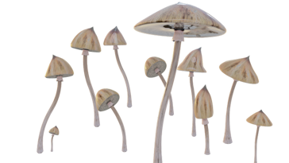


Psychedelics
in the treatment of dementia?
Daniele Zullino
WHO collaborating center

Slide 2
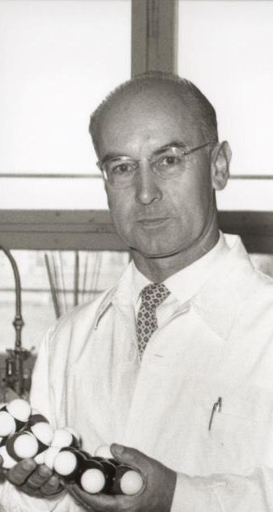
LSD
1938 first synthesis of LSD-25 from rye ergot fungus
1943 Hofmann re-synthesizes LSD
16.4.1943 Accidental contamination
19.4.1943 Intentional intake of 250𝛍g - Bicycle Day experience
→ Sandoz brings Delysid® onto the market
Albert Hofmann
1906-2008

Slide 3
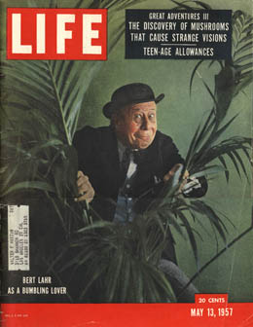

1st psychedelic era
1957, Article by R. Gordon Wasson
Encounter with Mazatec healer Maria Sabinas
Mass travel to Mexico after publication

Slide 4
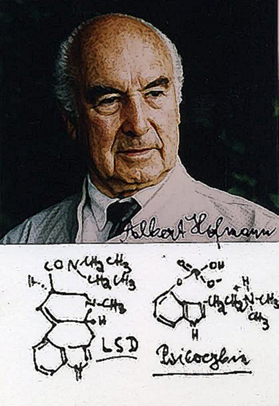
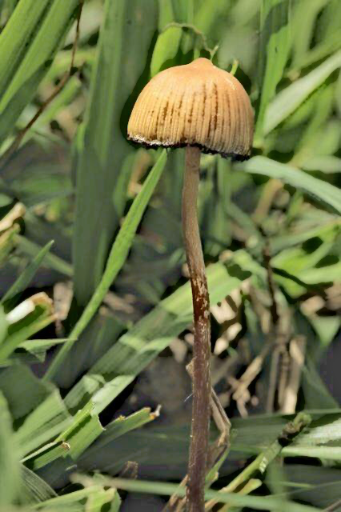
Psilocybine
1958
Identification of psilocybin and psilocyne by Albert Hofmann from Psilocybe mexicana Heim

Slide 5
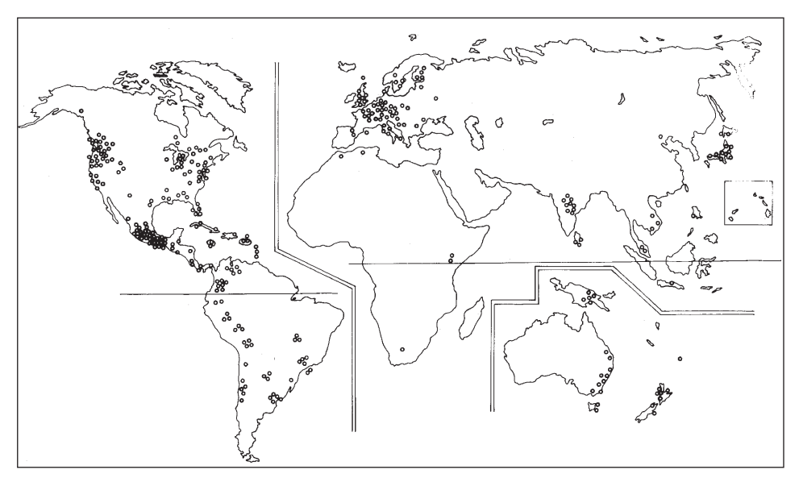

Slide 6
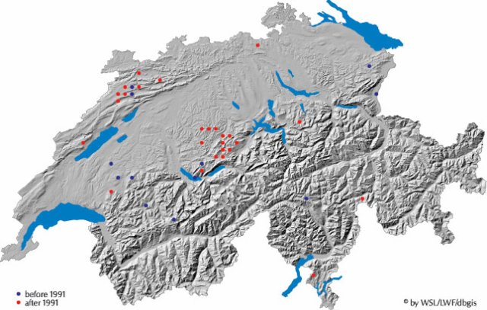
evasion-artificielle.skyrock.com

Slide 7
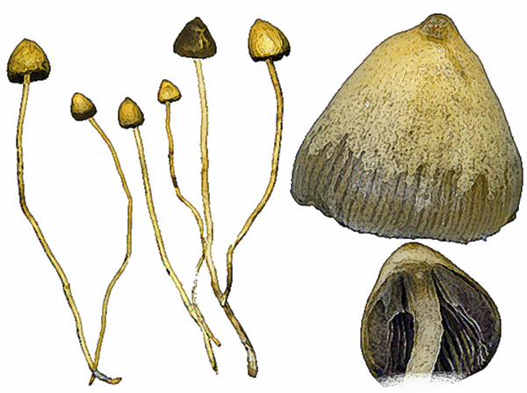
Psilocybe semilanceata

Slide 8
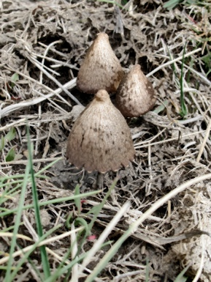
The mushroom
  Prefers well-drained soils
  Immature mycelium sensitive to water excess
  Mature mycelium requires plenty of water
  CH: grows in late summer and autumn after rains
  Often around old cow dung
Musshoff et al., 2000; Badham, 1984

Slide 9

1970 Drug Abuse and Prevention Control Act: psilocybin and LSD classified as Schedule 1 drugs
... has a high potential for abuse, has no recognized medical use, and use in a medical setting is not safe...
Clinical research no longer authorized
Credit: AP

Slide 10
LSD
Psilocybine
Onset of effect 30 - 60 min after intake
Onset of effect 10 - 40 min after intake
Peak effect after approx. 1½ h
lasts 2 - 6 hours
gradual decrease in effect up to 5 hours, effect may be felt for up to 12 hours

Slide 11
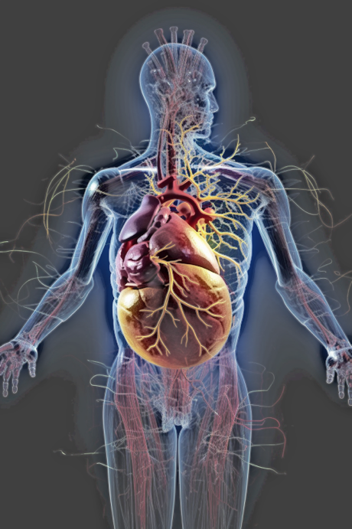
Effects on physiological functions
Initially nausea, sweating, feeling hot, palpitations, dizziness and/or anxiety
Paresthesias
Mydriasis
 heart rate (~10/min) and blood pressure (~20mmHg)
No effect on ECG, temperature
No effect on cortisol, prolactin, growth hormone
Gouzoulis-Mayfrank et al., 1999; Passie et al., 2002; Hasler et al., 2004

Slide 12
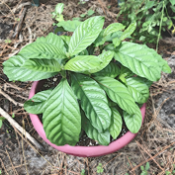




Ayahuasca
DMT
Psychotria viridis
Harmin
Banisteriopsis caapi

Slide 13
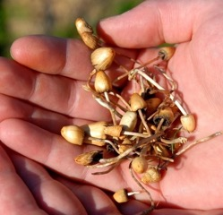
Psycholytic therapy
Psychedelic therapy
Developed in Europe
Psychoanalytically inspired
Repeated low-to-medium doses
Therapist intervenes during session
Mainly studied in North America
1-3 higher doses
Peak experience
Therapist does not intervene during session

Slide 14
Tretter, 2021

Slide 15

Psilocybin for Depression in People With Mild Cognitive Impairment or Early Alzheimer's Disease
Johns Hopkins University, Baltimore
Study Type : | Interventional (Clinical Trial)
Estimated Enrollment : | 20 participants
Allocation: | N/A
Intervention Model: | Single Group Assignment
Masking: | None (Open Label)
Primary Purpose: | Treatment
Official Title: | Pilot Study of Serotonin 2A Receptor (5-HT2A) Agonist Psilocybin for Depression in Patients With Mild Cognitive Impairment or Early Alzheimer’s Disease
Actual Study Start Date : | March 24, 2021
Estimated Primary Completion Date : | December 30, 2024
Estimated Study Completion Date : | December 30, 2024

Slide 16
LSD, Phase I
48 subjects, average age 62.9
5, 10, 20 𝛍g LSD
No adverse effects > placebo
No cognitive effects
Cambridge Neuropsychological Test Automated Battery (CANTAB)
Reaction time
Paired associates learning
Rapid visual information processing
Spatial working memory
Family et al., 2020

Slide 17
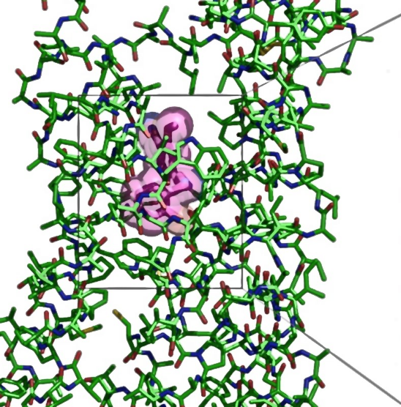
5HT2A-R and cognition
Particularly high concentrations of 5HT2A-R in prefrontal cortex and hippocampus
5HT2A-R polymorphisms associated with verbal memory recall and object recognition.
5HT2A-R activation by LSD → improves prospective and retrospective learning in a dose-dependent manner
Reduced 5HT2A-R density in the hippocampus worsens cognitive performance
Jones & O’Kelly, 2020; Buchborn et al., 2014; Cini et al., 2019, Schott et al., 2011

Slide 18

5-HT2AR learning & memory
Rodents
LSD and psilocybin help extinguish fear memories
Selective 5-HT2AR antagonism → ↓spatial inversion learning and ↑ perseverance errors.
LSD injections into the hippocampus → ↑ classical conditioning
King et al. 1972; Boulougouris et al. 2008; Romano et al. 2010; Zhang et al. 2013; Catlow et al. 2013; Wiessner et al., 2022

Slide 19

Psychedelics and cognition
In humans
↑ cognitive flexibility in patients with depression up to four weeks after psilocybin
50 μg LSD modifies over > 24 hours
↑ visuospatial memory (immediate recall and consolidation)
↑ verbal fluency
Regular ayahuasca users: better results on tests of behavioural inhibition, cognitive flexibility, working memory and executive functioning
Wiessner et al., 2022; Doss et al., 2021

Slide 20


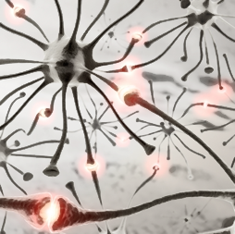
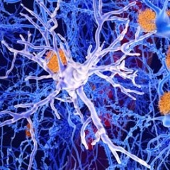
3 argumentative axes
Neural
network reorganization
Neuroplasticity
Anti-inflammatory
effects

Slide 21
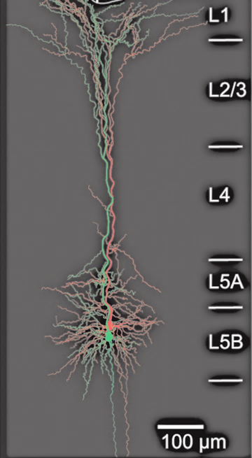
Deregulation/new regulation
of cortical activity
Psilocybin stimulates 5-HT2A receptors on layer 5 pyramidal cells
responsible for cortical integration
Nutt et al., 2020

Slide 22
Petri et al., 2014; Carhart-Harris, 2019

Slide 23

Default mode network (DMN)
Resting DMN activity required for memory consolidation
↓ functional connectivity in DMN in Alzheimer's patients
Functional connectivity disturbances in DMN overlap with amyloid deposition patterns
Memantine and donepezil → ↑ functional connectivity in DMN.
Stimulation 5-HT2A → disintegrates default mode network (DMN)
  → Hyperconnectivity
  → Increased brain entropy
Kozlowska et al., 2022; Mohan et al., 2016; Beason-Held, 2011; Hafkemeijer et al., 2012; Ouchi & Kikuchi, 2012

Slide 24

5-HT2AR and neuroplasticity
5-HT2AR stimulation
→ ↑ expression proteins involved in cytoskeletal rearrangements
→ ↑ proBDNF levels and ↓ TrkB receptors
LSD and psilocybin
  ↑ serum BDNF levels
  → ↑ expression immediate early genes (IEG) involved in synaptic plasticity
  → ↑ synaptogenesis
Nichols et al. 2003; Nichols and Sanders-Bush 2002; González-Maeso et al. 2007; Tsybko et al. 2020; Donovan et al. 2021;
Raval et al. 2021; De Vos et al., 2021

Slide 25
Increased branching
cortical neurons (DIV6)
Effect mediated by 5-HT2AR, blocked by ketanserin
Ly et al., 2020

Slide 26
Increased number
of dendritic spines
Ly et al., 2020

Slide 27
Increased synaptogenesis
Ly et al., 2020

Slide 28
Neuroplasticity
Calder & Hasler, 2022

Slide 29
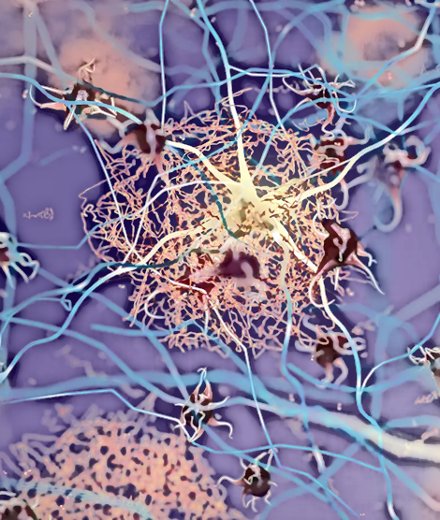
Anti-inflammatory effects
LSD, DMT → ↓ pro-inflammatory biomarkers, including IL-1β, IL-6 and tumor necrosis factor-α (TNF-α)
blocked by 5-HT2A-R antagonist
Ayahuasca → ↓ C-reactive protein
Yu et al. 2008; Nau Jr et al. 2013; Szabo et al. 2014; Galvão-Coelho et al. 2020; Kozlowska et al., 2022

Slide 30
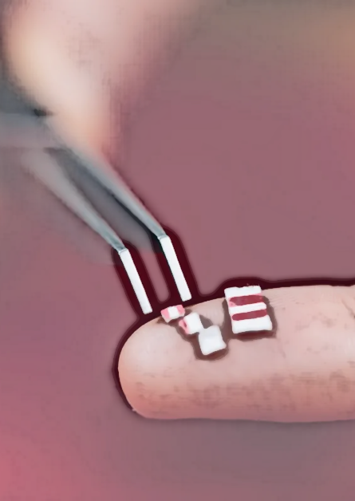
Micro-Dosing
↑ Open-mindedness and creativity, ↓ negative emotionality (?)
Anecdotal evidence: cognitive benefits
Open and naturalistic study: psilocybin micro-doses → ↑ cognitive fluency, flexibility and originality.
2 controlled studies with LSD microdosing: no positive or negative effect on cognitive functions
Anderson et al., 2019; Jones and O'Kelly, 2020; Prochazkova et al., 2018; Bershad et al., 2019; Hutten et al., 2020

Slide 31
Psychedelics theoretically promising treatment
3 argumentative axes
Neural network reorganization
↑ Neuroplasticity
Anti-inflammatory effect

