Slide 1



Is it time to consider cocaine-assisted
treatment for crack addiction?
Daniele Zullino
WHO collaborating center

Slide 2

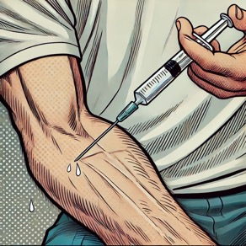

Pharmacokinetic differences
Sniffed
Intravenous
Inhaled
Latency1-3 min
Peak 15-30 min
Latency 30-120 sec Peak 5-10 minutes
Latency 3-10 sec Peak 2-5 minutes

Slide 3

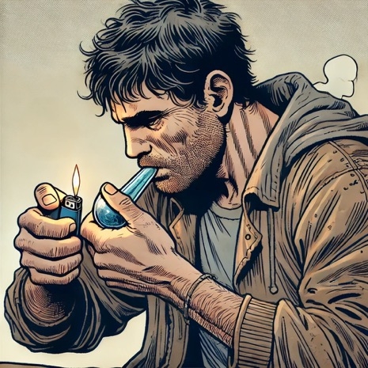

What we usually think
Toxicity crack
Social marginalisation
What studies reveal
Van Der Poel & Van De Mheen, 2006; Krawczyk et al., 2015

Slide 4





specific pharmacological properties
specific user
profiles
Therapeutic
approaches
Cocaine
user
specific consumption circumstances

Slide 5

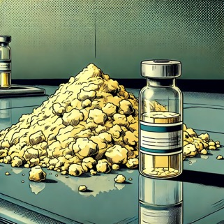
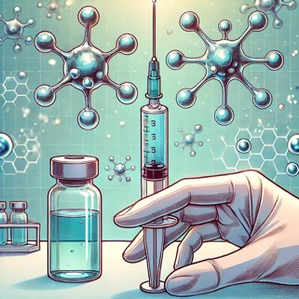
Pharmacological approaches
Actions on addiction mechanisms
Agonist treatments
Substitutive actions
Immunotherapies and vaccines

Slide 6
Cocaine HCl
Crack
Promising preliminary data
N-Acetylcysteine, disulfiram
Disulfiram
Galantamine, THC,
quetiapine, aripiprazole, vigabatrine, baclofène,
tiagabine
Topiramate, THC
Mixed data
D-Cycloserine, bupropion, rispéridone, olanzapine, antidépresseurs, acamprosate, memantine
CBD
Clearly negative
data
Carroll et al. 2018; Kennedy et al. 2012; LaRowe et al. 2006, 2007, 2013, Mardikian et al. 2007, Amen et al. 2011, Levi Bolin et al. 2017, Schulte et al. 2018; Carroll et al. 1998, McCance-Katz et al. 1998, Carroll et al. 2000, Grassi et al. 2007, Pettinati et al. 2008; Carroll et al. 2004, 2016; Petrakis et al. 2000, Oliveto et al. 2011, Carroll et al. 2012; George et al. 2000, Schottenfeld et al. 2014;
Baldacara et al. 2013; Kampman et al. 2004, Johnson et al. 2013, Kampman et al. 2013, Prince u. Bowling 2018; Pirnia et al. 2018; Mariani et al. 2012, Levin et al. 2020; Nuijten et al. 2014;
Baldacara et al. 2016; Margolin et al. 1995, Montoya et al. 2002, Ware et al. 2023; Costa et al. 2015; Labigalini et al. 1999; Socıas et al. 2017; Meneses-Gaya et al. 2021; Kampman et al. 2003,
Grabowski et al. 2004b, Loebl et al. 2008, Hamilton et al. 2009; Beresford et al. 2005, Vorspan et al. 2008, Meini et al. 2011; Amato et al. 2007; Pani et al. 2011; Bisaga et al. 2010, Kampman 2010,
Somoza et al. 2013; Fechtner et al. 2006, Brodie et al. 2009, Somoza et al. 2013; Shoptaw et al. 2003, Kahn et al. 2009) und Tiagabin (Goodman et al. 1997, Gonzalez et al. 2003,
Winhusen et al. 2005, 2007

Slide 7
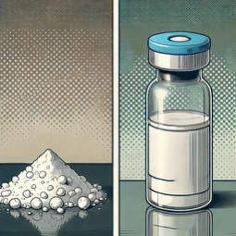
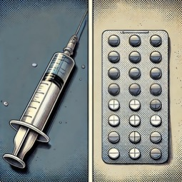
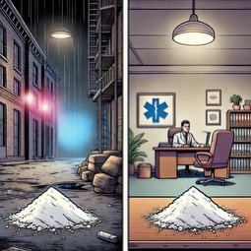
Agonist treatments
Less problematic
substance
Same substance
Less problematic
product
Same product
Other Context

Slide 8
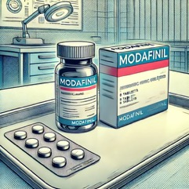
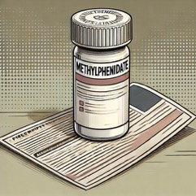
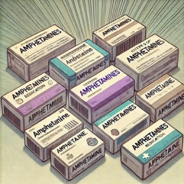
Substances studied so far
Modafinil
Methylphenidate
Amphetamines
Weak dopamine reuptake inhibitor, effects on orexinergic, histaminergic, glutamatergic and GABAergic systems
Human laboratory: ↓ positive subjective effects of cocaine, ↑ cognitions
Therapeutic studies → conflicting results
Structurally close to amphetamines
↓ subjective cocaine effects
Controlled studies mostly negative
Maximum dose administered 90mg
↓ subjective cocaine effects
Clinical studies at high doses → sometimes positive
high drop-out rate
slow release > immediate release

Slide 9
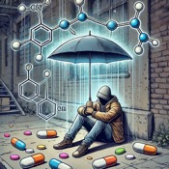
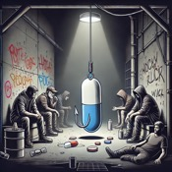




What do you need for effective therapy?
Engagement
Retention
Harm
reduction
desirability
acceptability
↓ addictive processes
The desired product
fast-acting, addictive
The slow substance
Delayed effect, less addictive

Slide 10
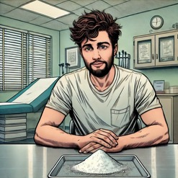
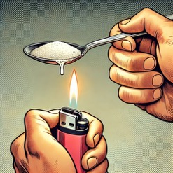

CAT
Cocaine-assisted treatment
Cocaine HCl
Crack to be cooked by patient
Inhalable
cocaine
Cocaine HCl
either intravenously, nasally or orally
slower kinetics
Slowing down the consumption process
Reduces impulsive behaviour
Focus on harm reduction and attractiveness

Slide 11
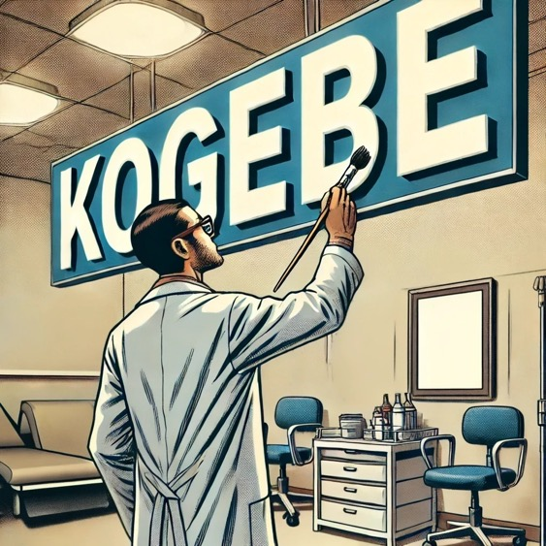
What can be learned from HeGeBe?
Successful harm reduction
Attractiveness of offer
Combination of fast- and slow-acting substances
Relief in the urban scene
Psychosocial support interventions essential
Addressing the social and psychiatric determinants of addiction without imposing abstinence

