Slide 1
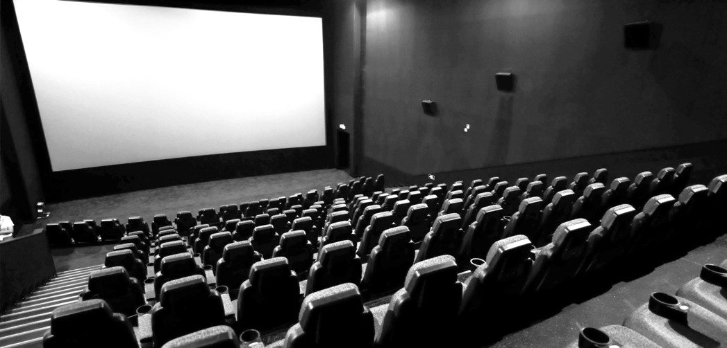


USING CINEMA TO TRAIN HEALTH PROFESSIONALS TO DIAGNOSE ADDICTIVE DISORDERS
Daniele Zullino
WHO collaborating center

Slide 2
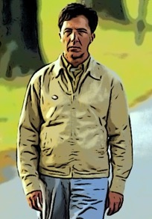
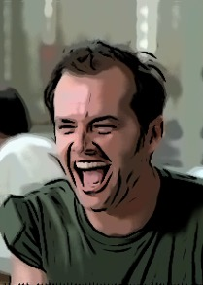
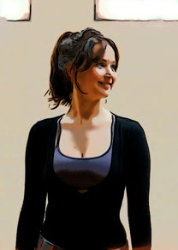
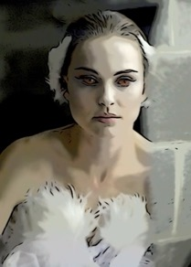
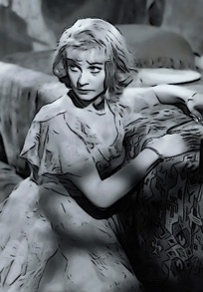
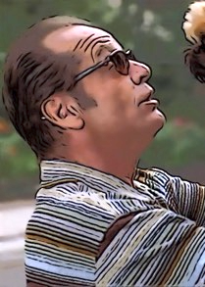
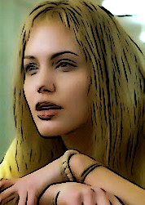
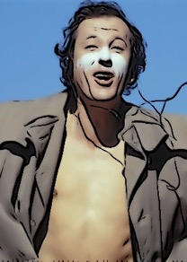
Mental illness and Academy Awards

Slide 3
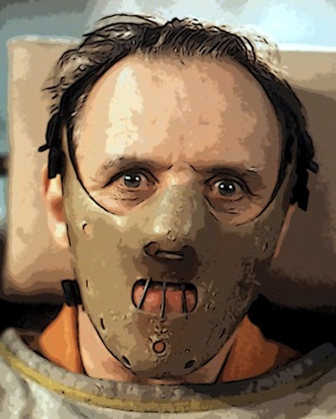
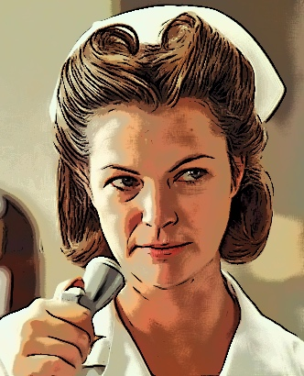
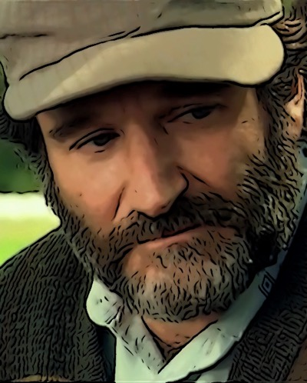
Mental Health Professional
and Academy Award

Slide 4
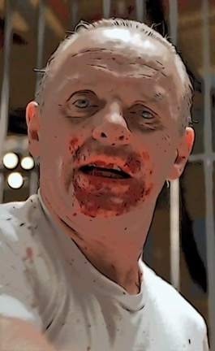
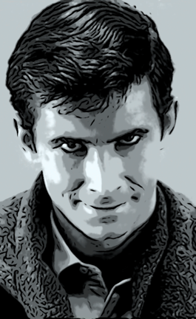
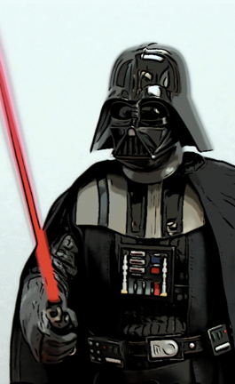
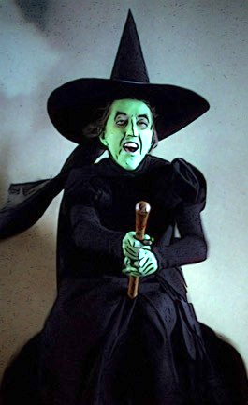
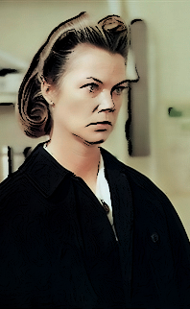
AFI - Top 5 screen villains of all time
1
2
3
4
5
Hannibal
Lecter
Norman
Bates
Darth
Vader
Wicked
Witch
Nurse
Ratched

Slide 5


Learning process
entertaining and enjoyable
Motivation
Effective learning

Slide 6
What film makes possible
Showing problems “in the situation”
e.g. drug injecting
psychopathological developments
Show otherwise covert psychological phenomena
e.g. merging real and hallucinated perceptions, reality and delusions

Slide 7




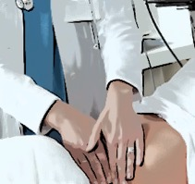






Slide 8

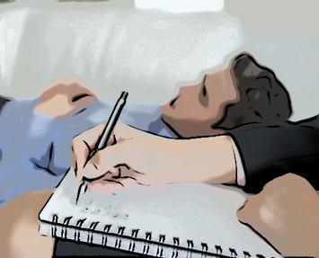

observing
listening
observing
listening
no problem
to ensure
Confidentiality ?

Slide 9


Slide 10
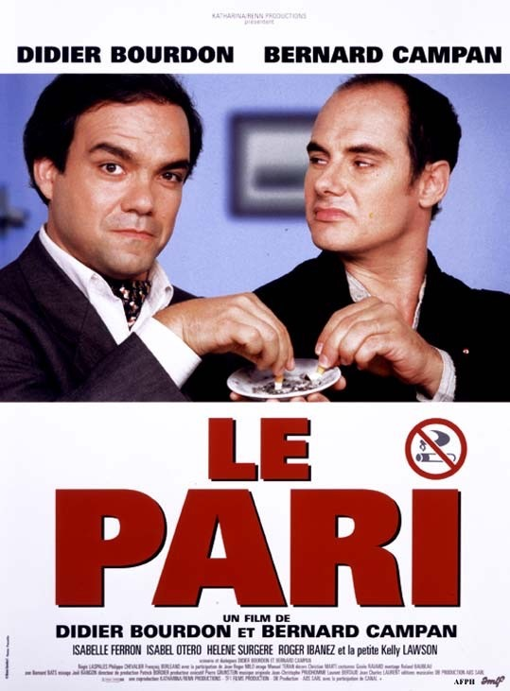
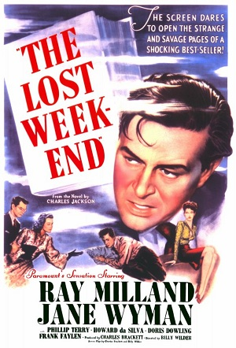

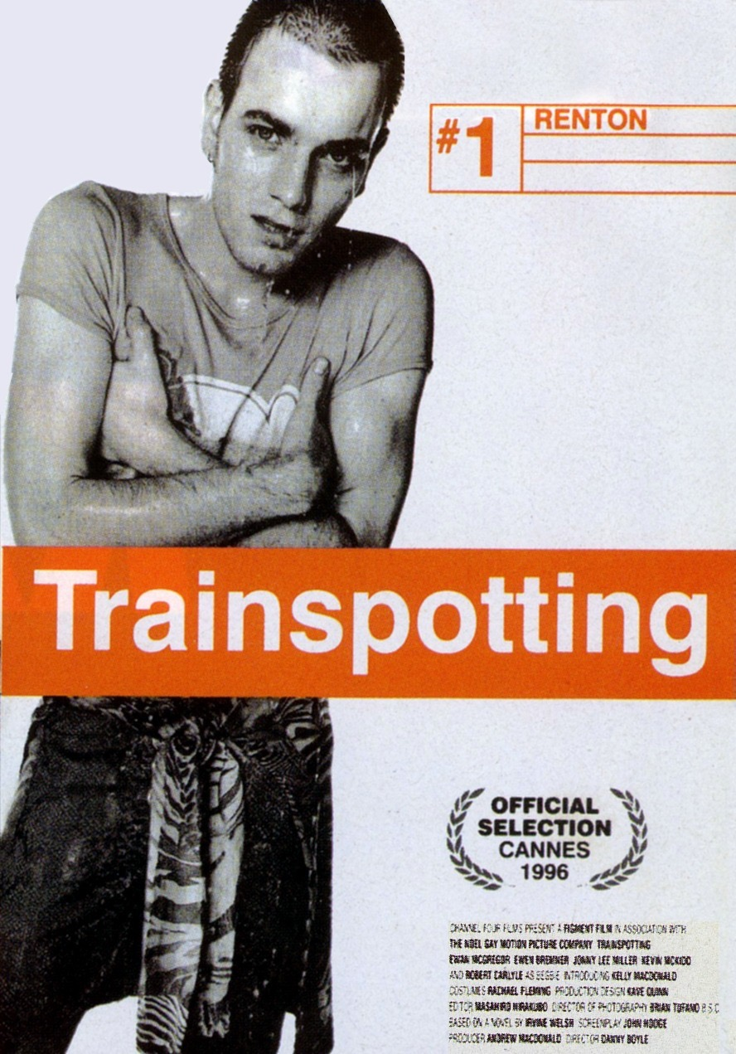
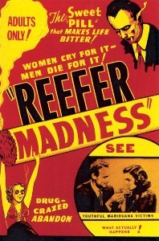
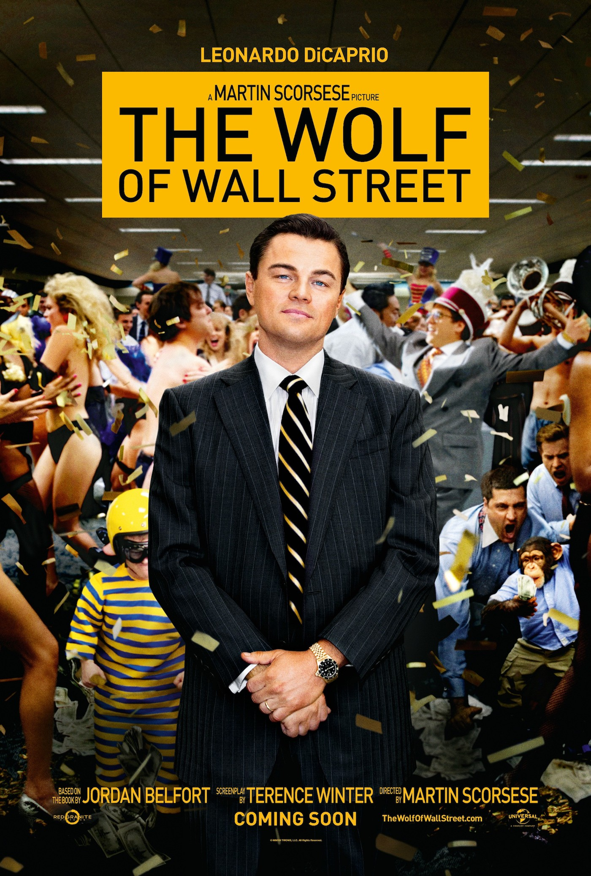
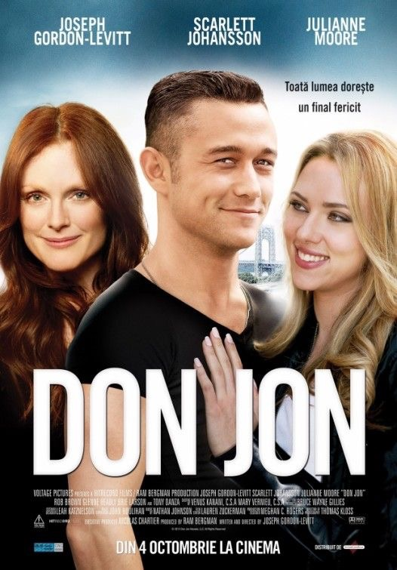
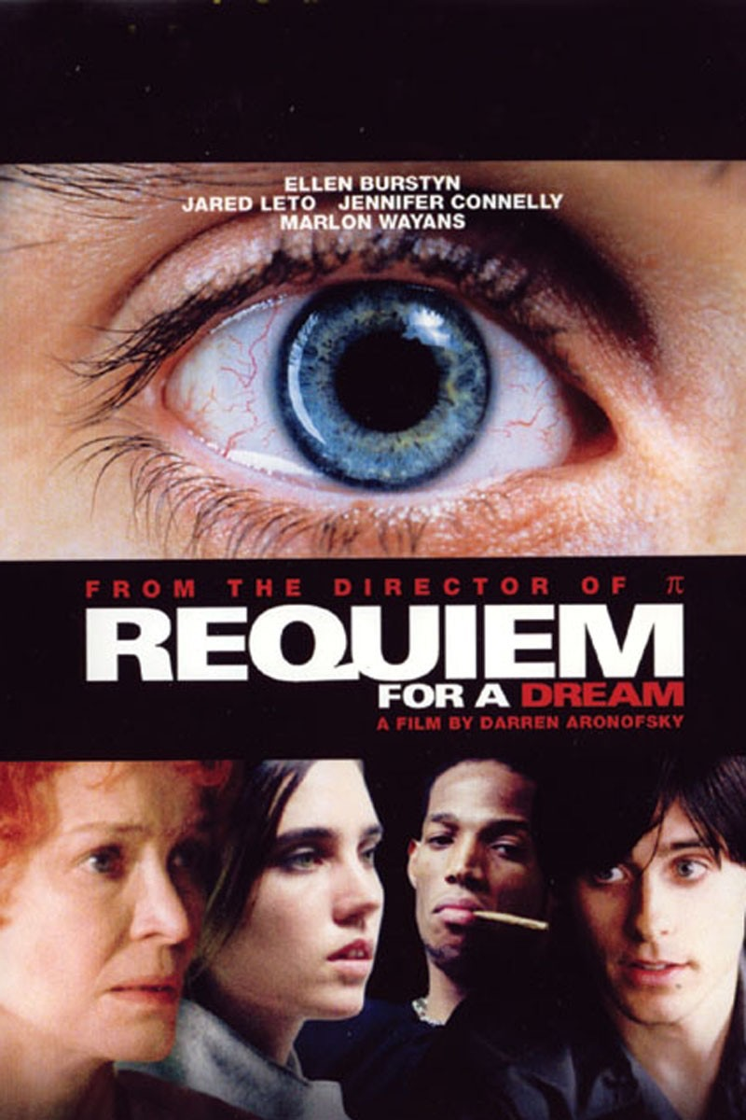

#1 | #2 | #3 | #4 | #5 | #6 | #7 | #8 | #9
OPIOID | ALCOHOL | STIMULANT | SEDATIVE | CANNABIS | HALLUCINOGENs | TOBACCO | GAMBLING | SEX

Slide 11
Fleiss' kappa
reliability of agreement between students
OPIOID | ALCOHOL | STIMULANT | SEDATIVE | CANNABIS | HALLUCINOGENs | TOBACCO
0.376*
0.474*
0.271*
0.154*
0.346*
0.335*
0.307*
* p < 0.05, i.e. Fleiss' kappa significantely better than chance.

Slide 12

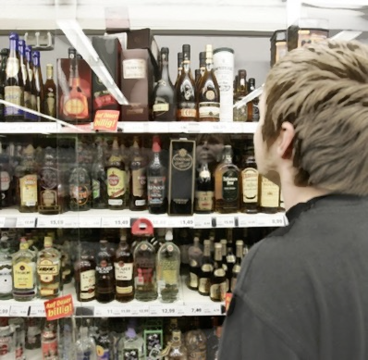
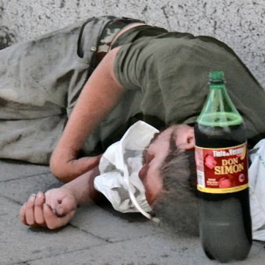
Central syndrome
addictive behavior
Secondary syndrome
consequences
little variance
large variance

Slide 13
core syndrome
secondary syndrome
tolerance
Chi² = 23.813, df = 1, p < 0.001

Slide 14
Conclusions
Psychiatry an interesting topic for movie makers
Mainstream movies interesting for training in psychiatry
engaging, motivating
illustration semiology, psychopathology
Mainstream movies suitable for psychiatry training

